Slide 1
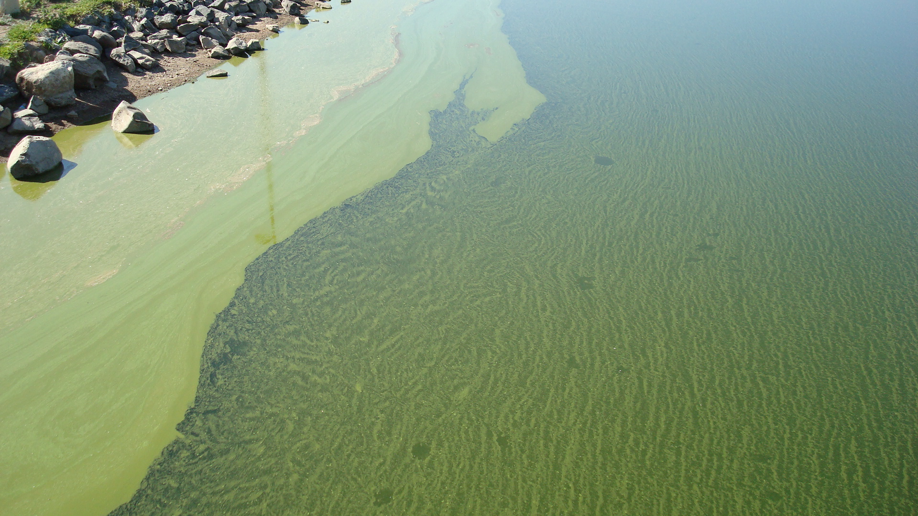
HABs: A Cost Perspective
Caleb Owen
City of Thornton
SPCURE: Confluence at the Confluence
12/14/21

Slide 2
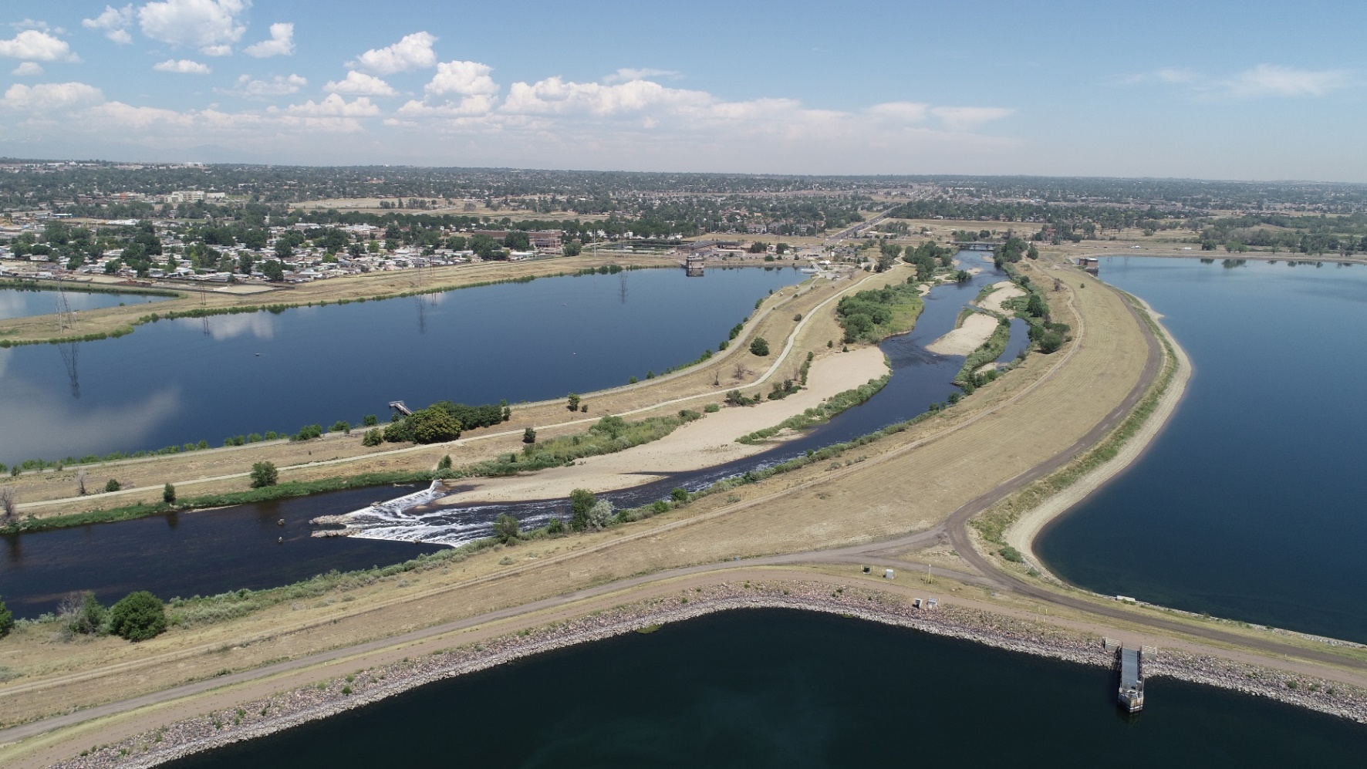
Overview
Thornton Overview
Monitoring Costs
Source Treatment Costs
WTP Chemical Costs
Capital Project Costs

Slide 3
Raw Water Supply
Upper Clear Creek
12K acft storage in Standley Lake
High quality source
Lower Clear Creek
2K acft storage in West Gravel Lake System
Okay quality source
South Platte River
21.2K acft in East Gravel Lake System
Challenging quality source

Slide 4
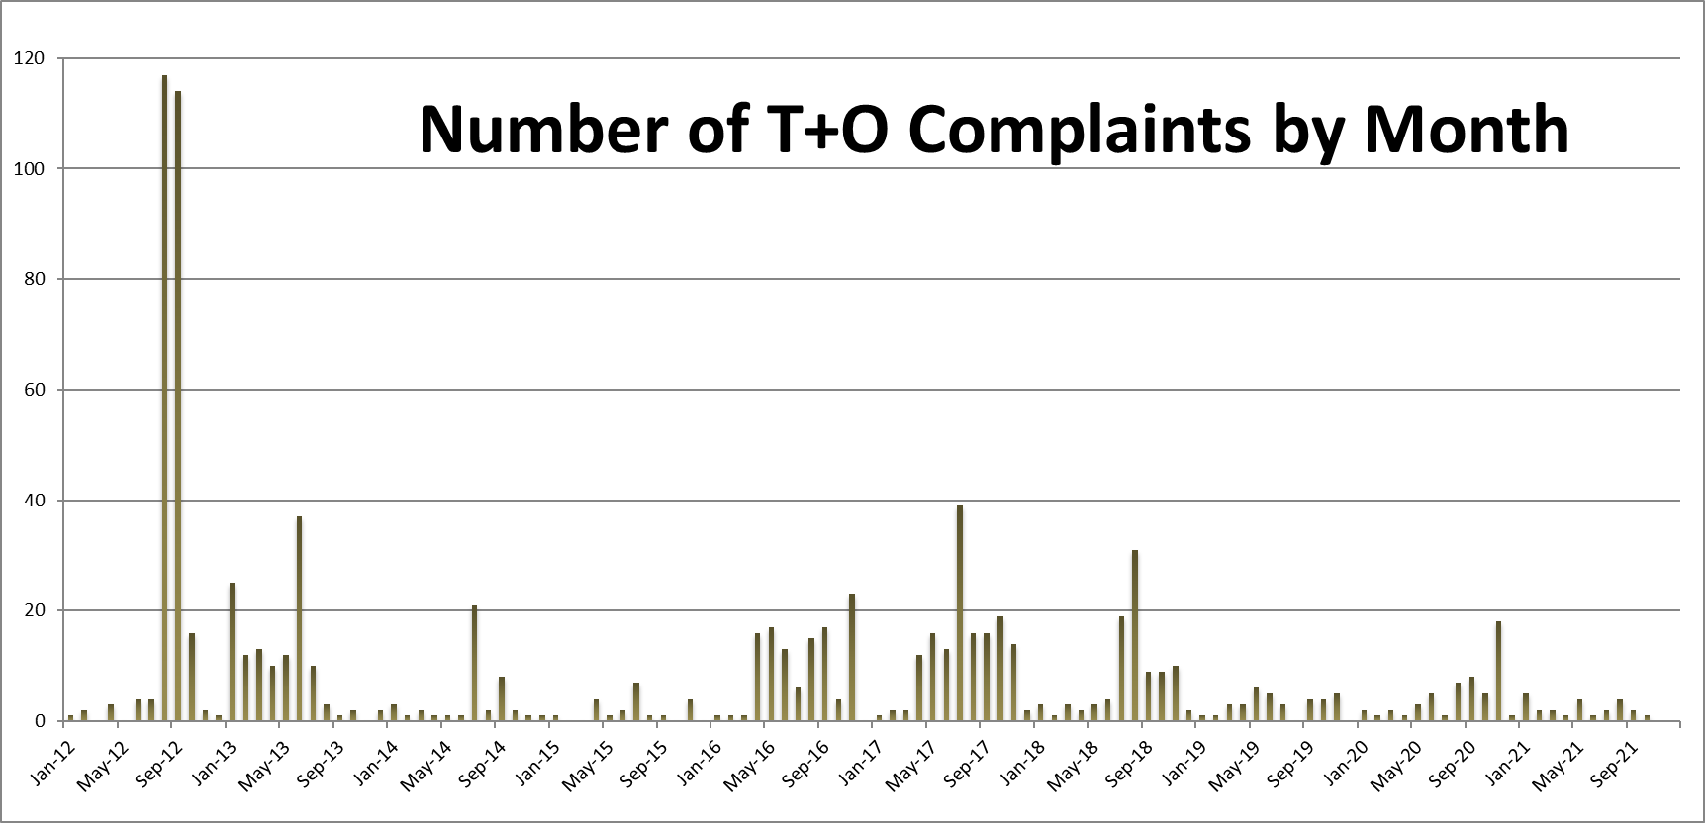
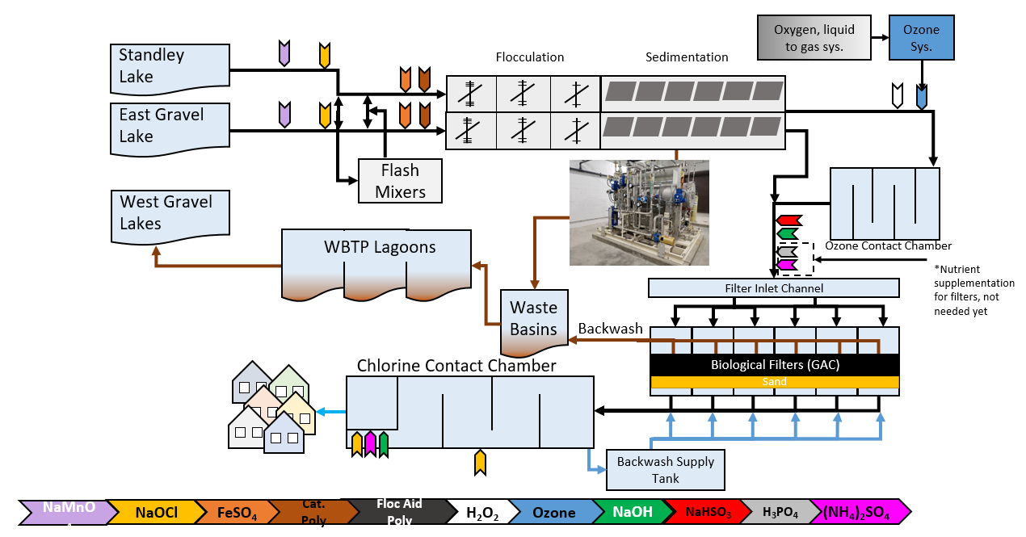
City of Thornton
~150,000 customers
38 MGD avg. summer consumption
Top customer complaint: T&O
Two WTPs
Wes Brown WTP - 50 MGD
Ultrafiltration Membranes
Treats SP & LCC
Retrofit 2005
Thornton WTP – 20 MGD
Advanced Oxidation and Biofiltration
Treats SP & UCC
Built 2020
~$100M

Slide 5
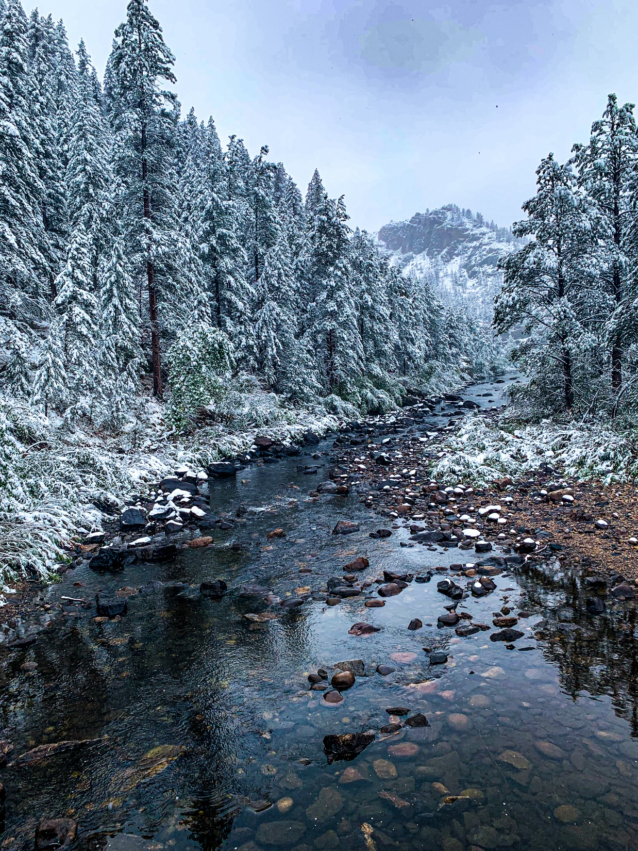
HABs Strategy
Monitoring
Visual Inspection
Lab –T&O, Algae, Chl-a, Toxins
Raw Water Treatment
Algaecide
SolarBees
Natural Attenuation
Water Treatment
Blending
Biofiltration
PAC
Wait it out until winter ☺

Slide 6
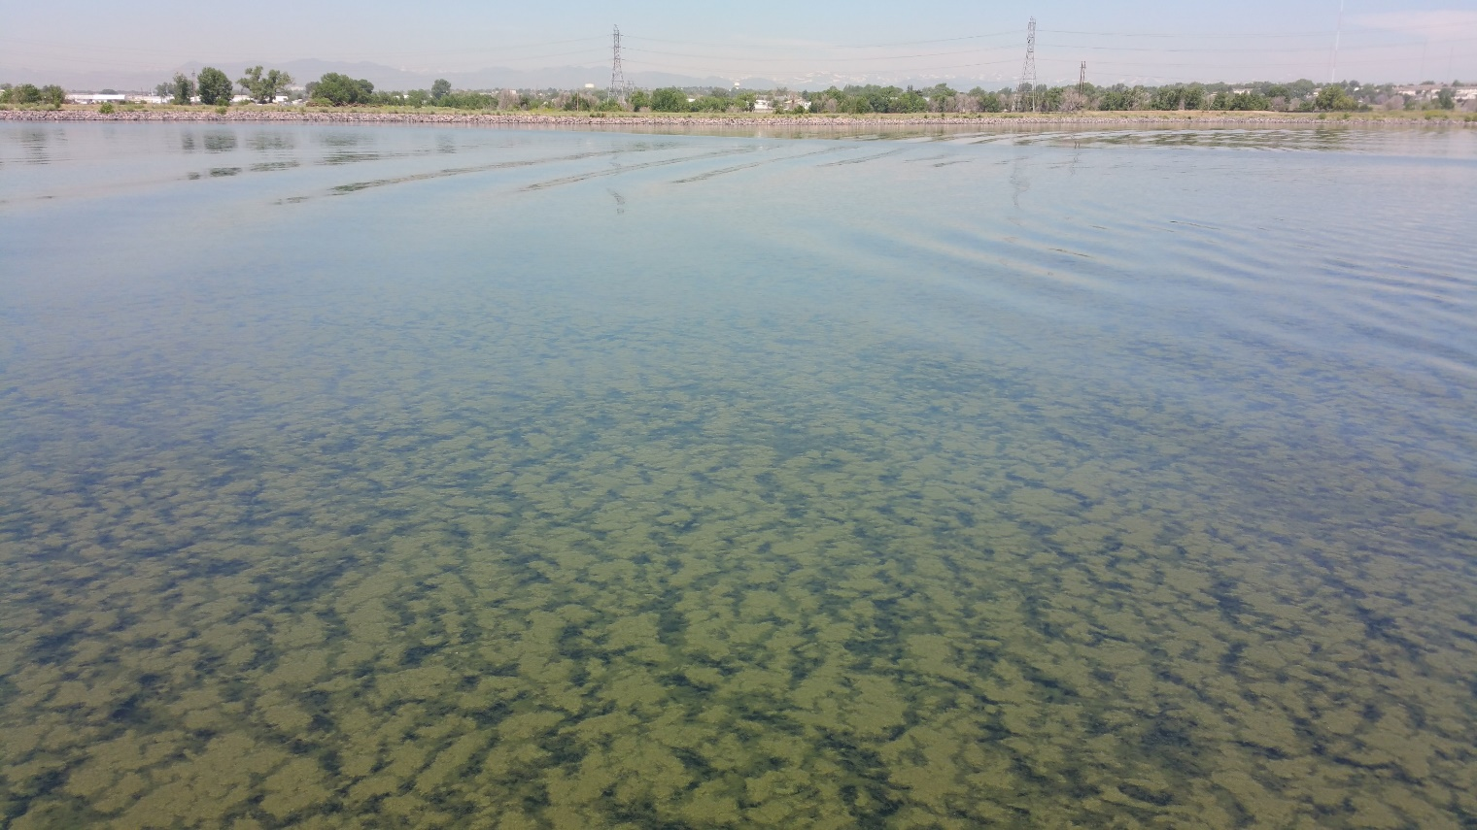
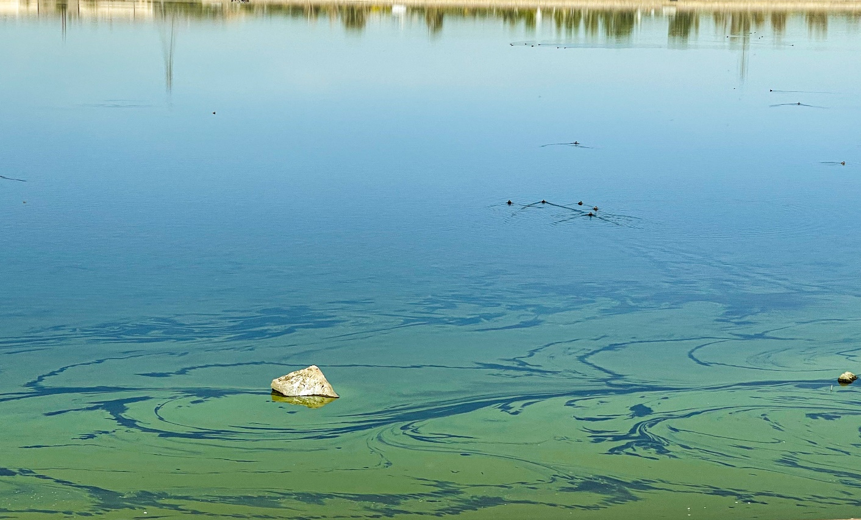
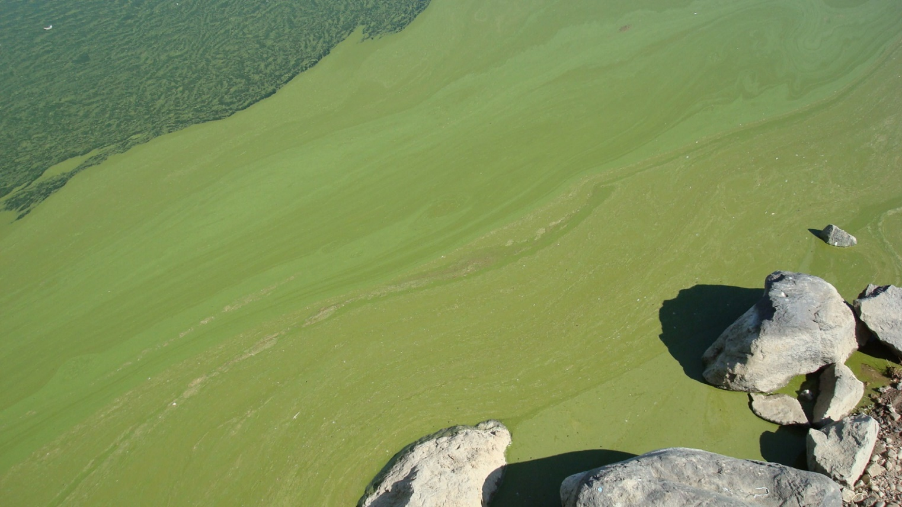
Visual Inspections
2-3 Inspections/wk
Very Important!
Try to catch blooms early

Slide 7
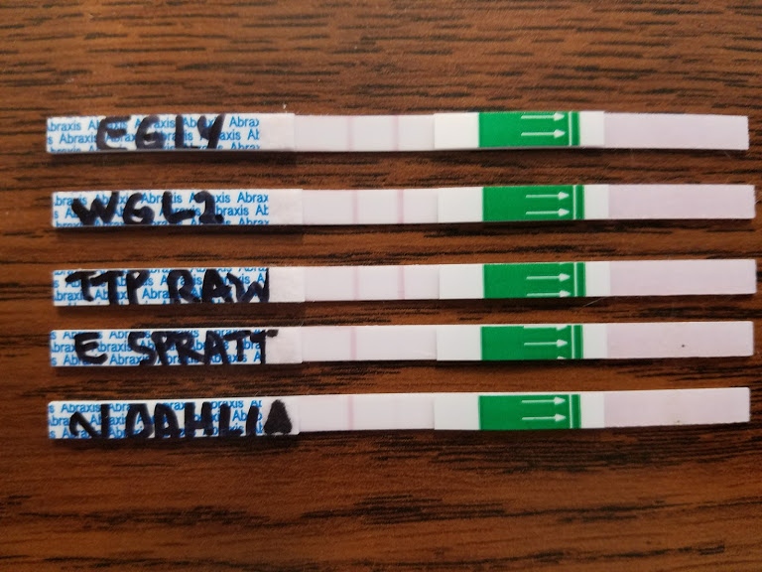
Toxin and T&O Monitoring
Weekly Abraxis Test Strips
3 lakes/wk
$3000/yr
LC-MS/MS Toxin Testing
2-3 lakes/qtr
$3000/yr
Confirmation testing req. for positive Abraxis tests
GC-MS T&O testing
11-19 samples/wk
$116,000 purchase price + $12K/yr service

Slide 8
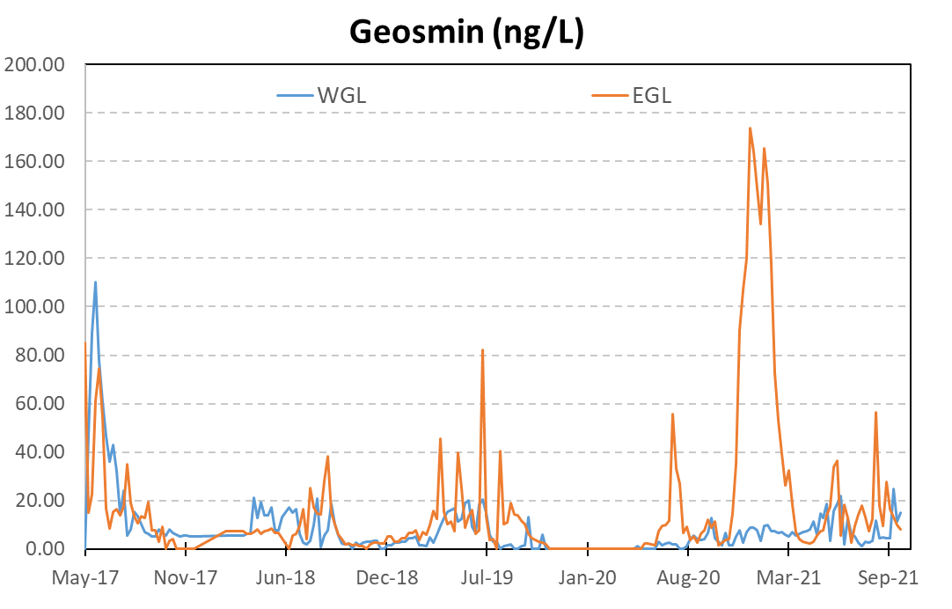
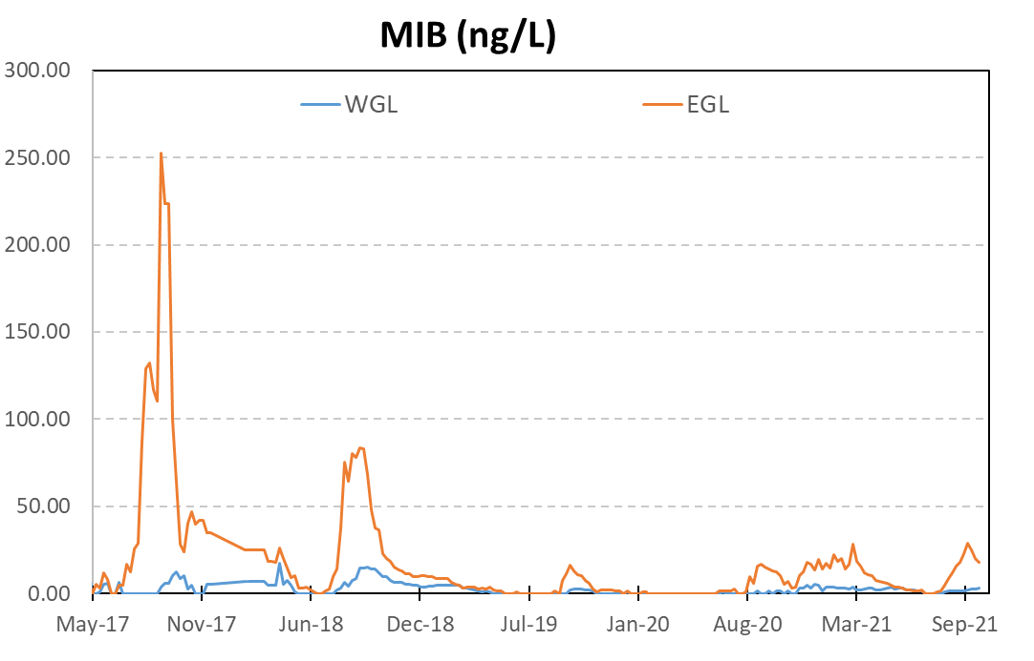
T&O - PACulator

Slide 9
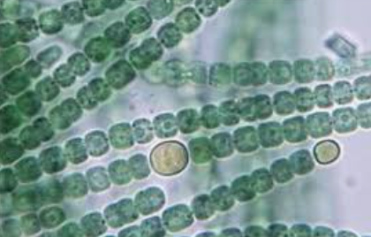
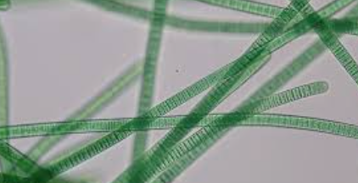
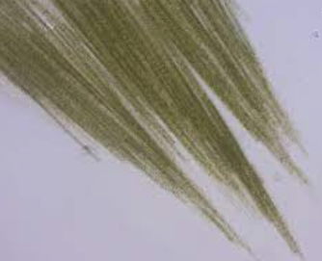
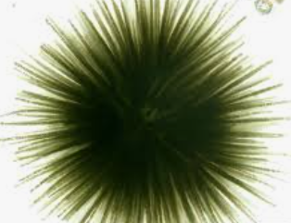
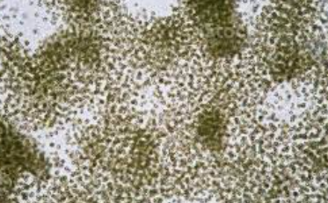
Algae & Chl-a Monitoring
Weekly monitoring
8 lakes/wk
1 staff, 2-3 hrs/wk
Helps guide algaecide application
Dominant Summer Species
SP: Anabaena, Microcystis, Oscillatoria, Aphanizomenon
LCC: More Chlorophytes + Anabaena, Microcystis, Oscillatoria
UCC: Diatoms

Slide 10
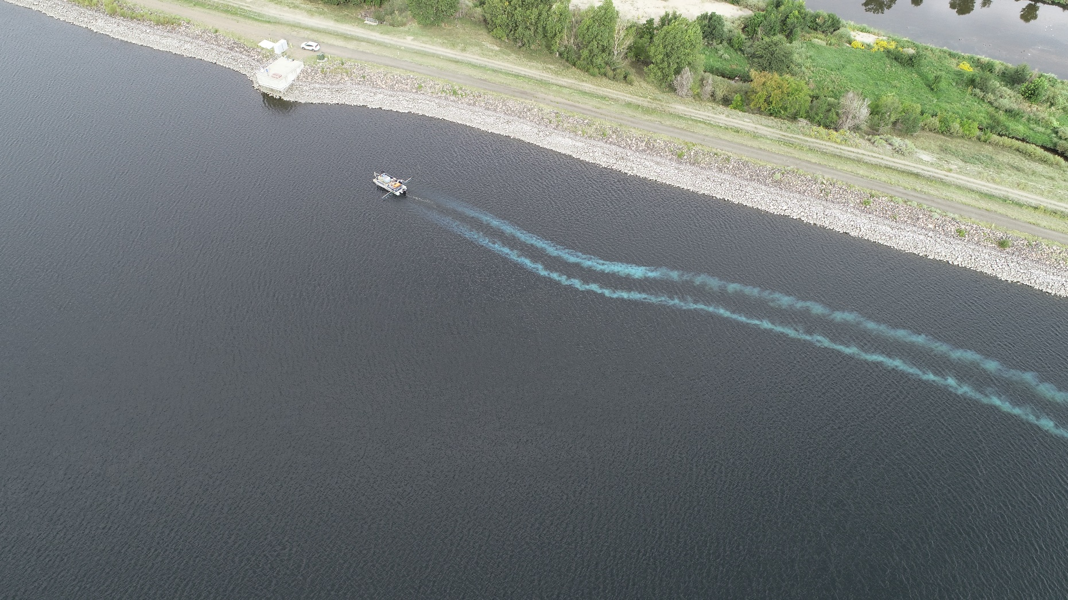
Algaecide
CuSO₄
$25,000/yr
Reqs. pontoon boat
2-3 staff member crew
Treat 2-3 lakes/day
4-5 treatments/lake/summer
Targeted applications

Slide 11
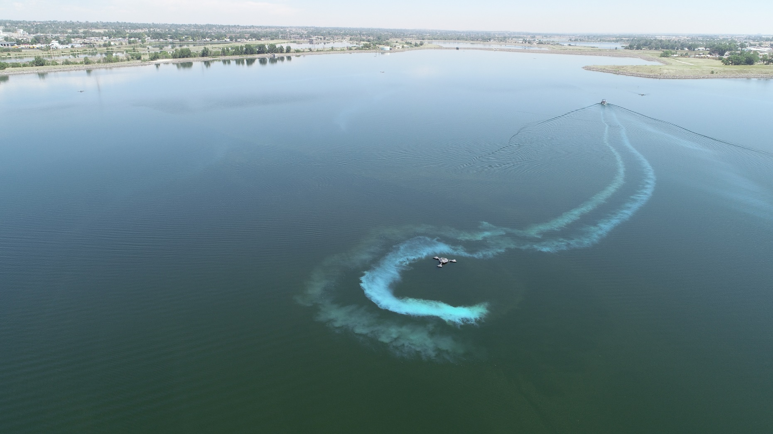

Slide 12
Raw Water Treatment
Solar Bees
3-8/lake in 3 lakes
$450K purchase + $36K/yr service
Cleaned monthly
2 person crew
Full day effort

Slide 14
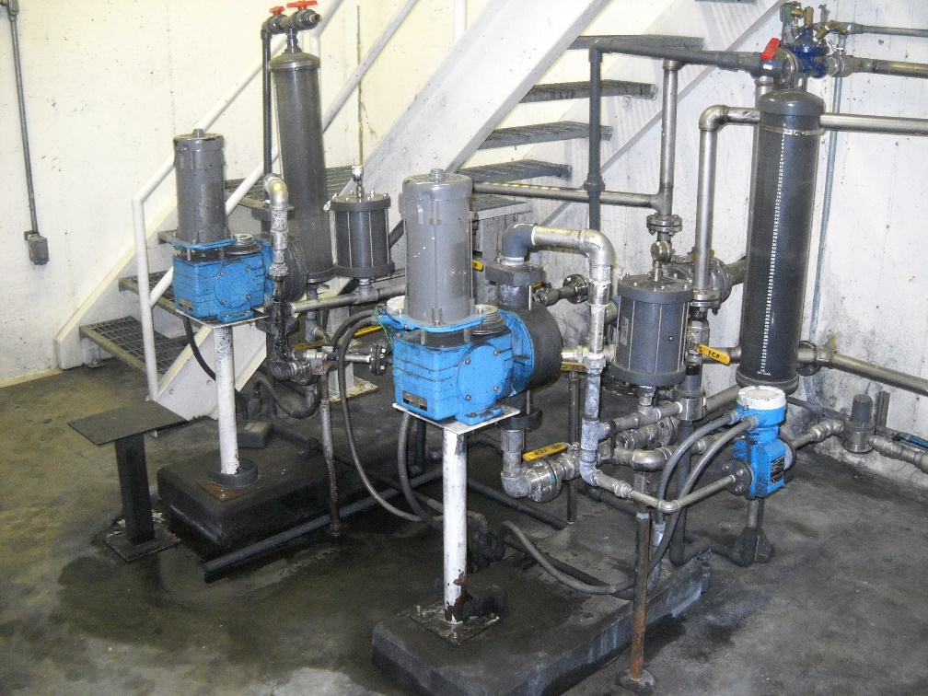
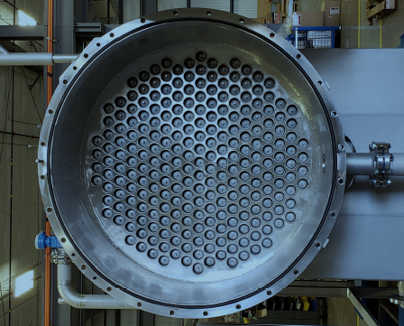
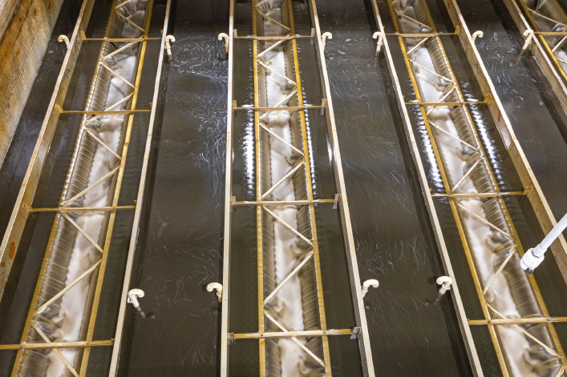
Chemical Costs
Wes Brown WTP
$0.33 - 0.51/Kgal
Avg. PAC $500K/yr
10-40 ppm dose
Up to $15K/day @ max flow & dose
Thornton WTP
$0.20 - 0.35/Kgal
Even at 100% SP source, cheaper to treat
Biofiltration > PAC

Slide 15
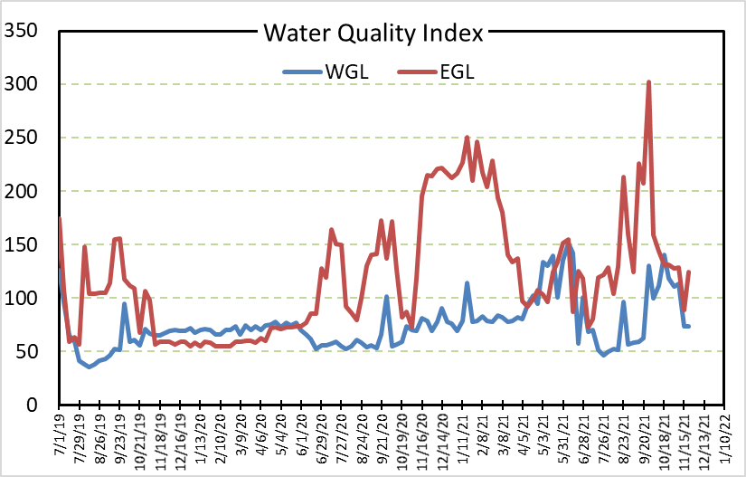
Blending
Quantity limited, especially Clear Creek supplies
New plant can treat SP
>99% T&O removal
Wes Brown Plant
Adjust according to WQI
~90% T&O removal max

Slide 16
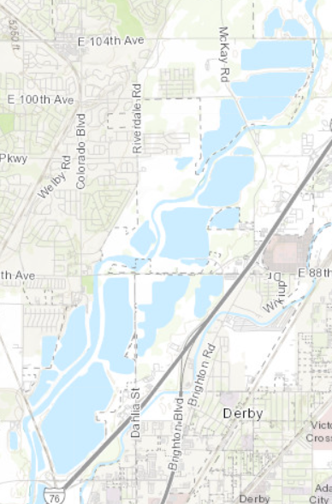
Other Projects
Lakes in Series
Move water through 7 lakes
~$240K annual pumping costs
Expecting natural attenuation of nutrients
Too soon to know WQ impact
Hypo Relocation
$1.8M project, completed 2019
Avg. saving $500K/yr on PAC and hypo costs

Slide 17
Summary
Thornton HABs Strategy
~$850K/yr
Excluding employee time
Best bang for your buck
Getting visual on the lake
Targeted algaecide, applied early in bloom
Frequent T&O monitoring to adjust PAC dose
Biggest Costs
PAC
Infrastructure
Personnel, Time, & Expertise

Slide 18
Questions?

