Slide 1
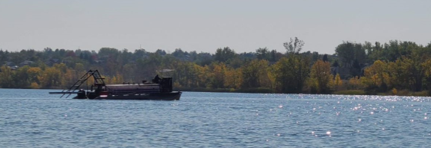
Quincy Alum Application
Sherry Scaggiari, Environmental Compliance Principal
City of Aurora

Slide 2
Background Information
Quincy is a DUWS Reservoir for City of Aurora
Aurora Water has a robust and redundant system that creates a variety of options for raw water.
Quincy is an important source during spring run-off for alkalinity control in the treatment process
Critical storage to maximize treatment capacity

Slide 3
Background Information
Used as a recreational amenity with fishing, non-motorized boating and walking paths.
All inflow into the reservoir is from the Aurora Rampart Reservoir
All effluent is pumped directly to a water treatment facility owned by Aurora.
Aurora Water maintains a comprehensive source water program to monitor the health of the reservoir.

Slide 4
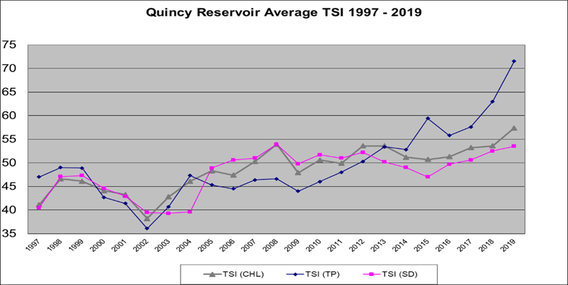
Carlson Trophic State Index

Slide 5
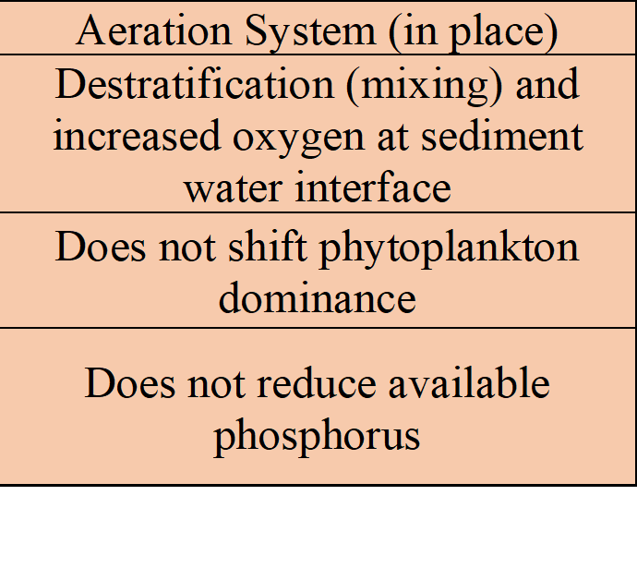
BMPs
Aeration system
Stormwater By-Pass Channel
Inflow monitored for quality

Slide 6
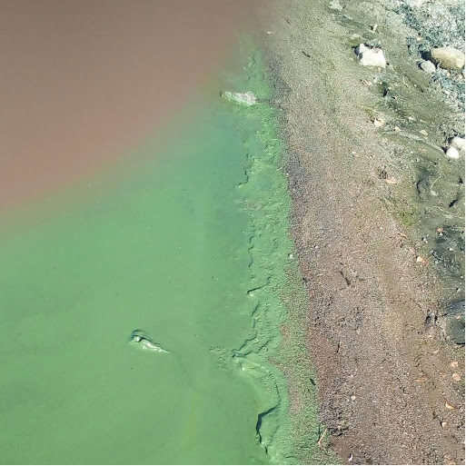
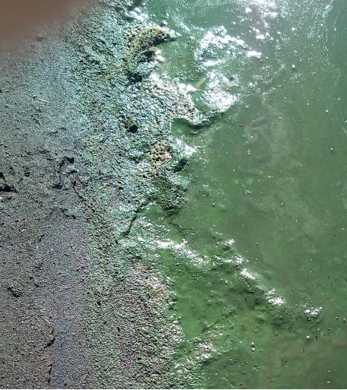
August 2019

Slide 7
Hydrogen Peroxide Treatment

Slide 8
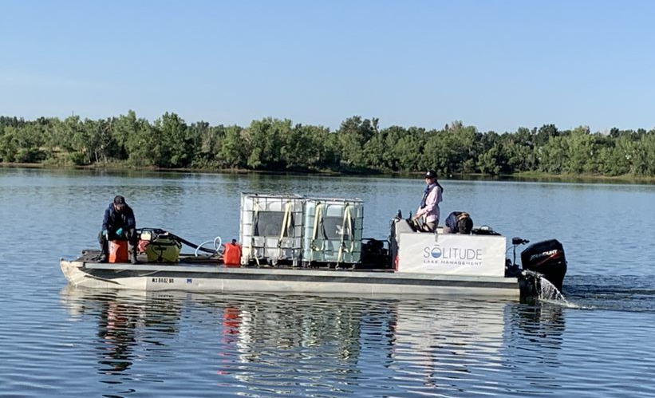
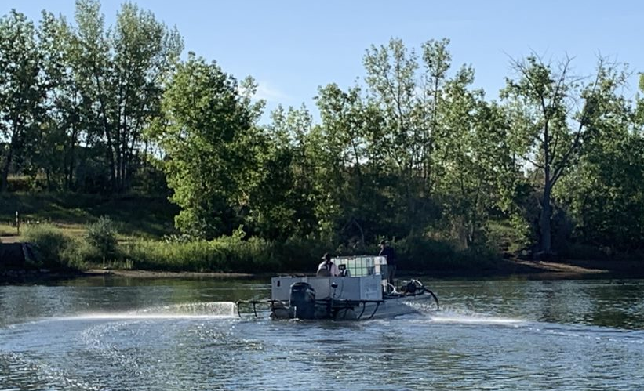
Hydrogen Peroxide

Slide 9
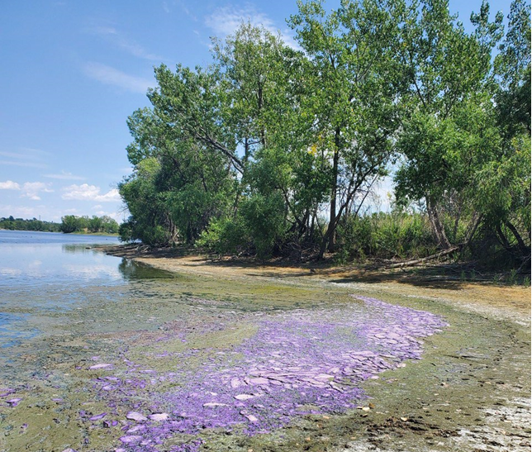
Now What?

Slide 10
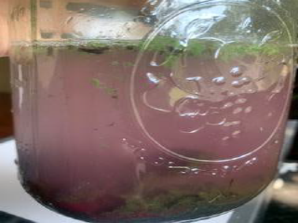
Purple Bacteria

Slide 11
Purple Sulfur Bacteria
This large population washed up this year because of the increased transparency from hydrogen peroxide treatment. While intermittent, it provides sufficient light for growth. Additionally, in theory, reduced cyanobacteria population in water column should provide more light for purple sulfur bacteria
Positive ecological roles such as conversion of H2S, which mitigates toxicity and provides a more conducive habitat. This is important as it will aid in reestablishing the upward flow of nutrient and energy.

Slide 12
New Plan
A short-term plan was developed for Quincy Reservoir with the intent of controlling phytoplankton growth during the 2020 growth season (April – November).
The goal of the short-term plan is to preserve options for the ongoing
analysis of alternatives for Quincy’s long-term plan.
Quincy reservoir is at a critical juncture for action to maintain water quality to balance investment in immediate actions and potential long-term improvements.

Slide 13
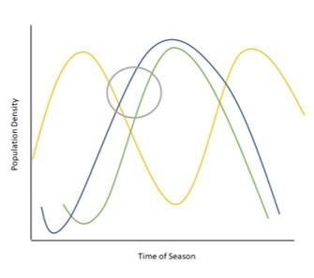
Timing is Everything
Biological Succession:
diatoms (yellow)
cyanobacteria (blue)
green algae (green)
target conditions for hydrogen peroxide treatments highlighted in grey circle

Slide 14
Combo Treatment

Slide 15
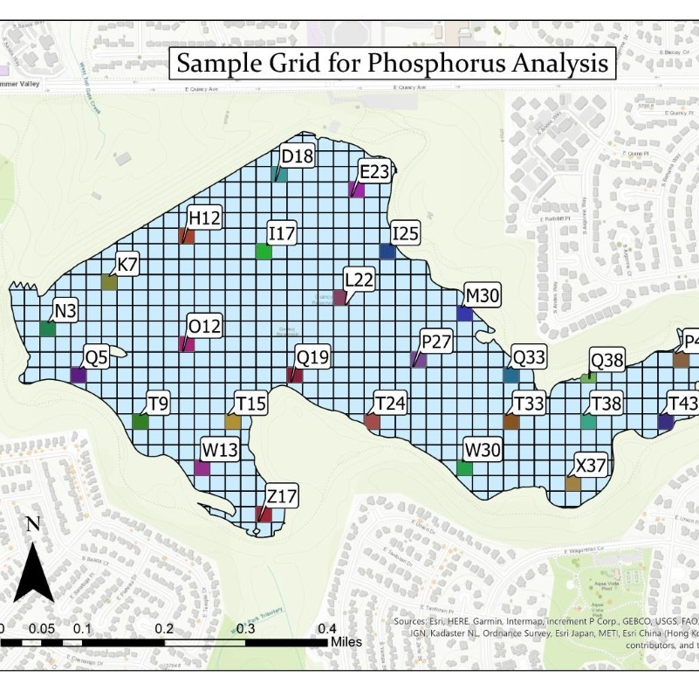
Phosphorus Analysis

Slide 16
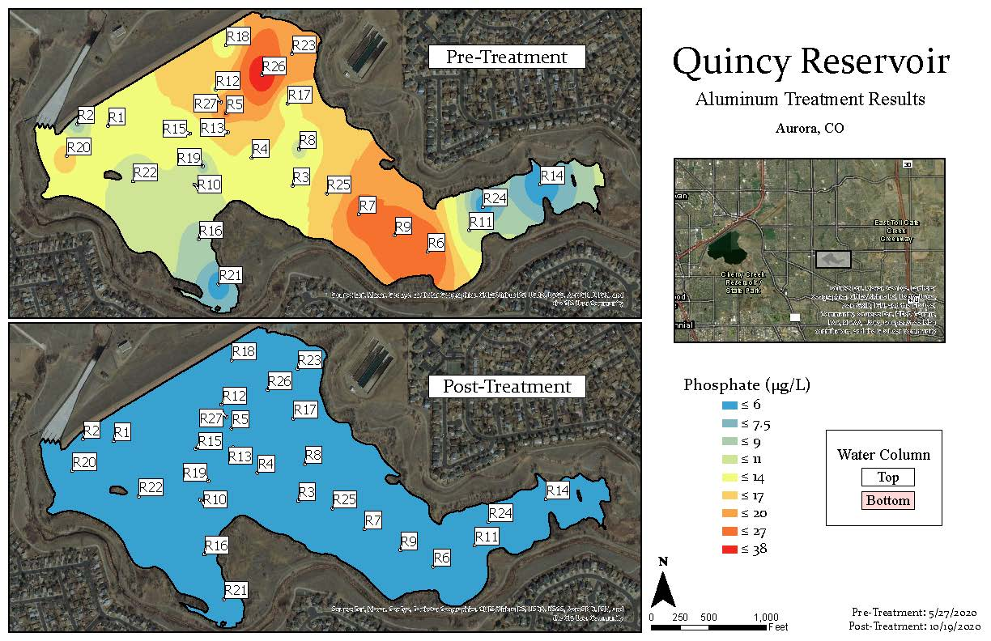

Slide 17
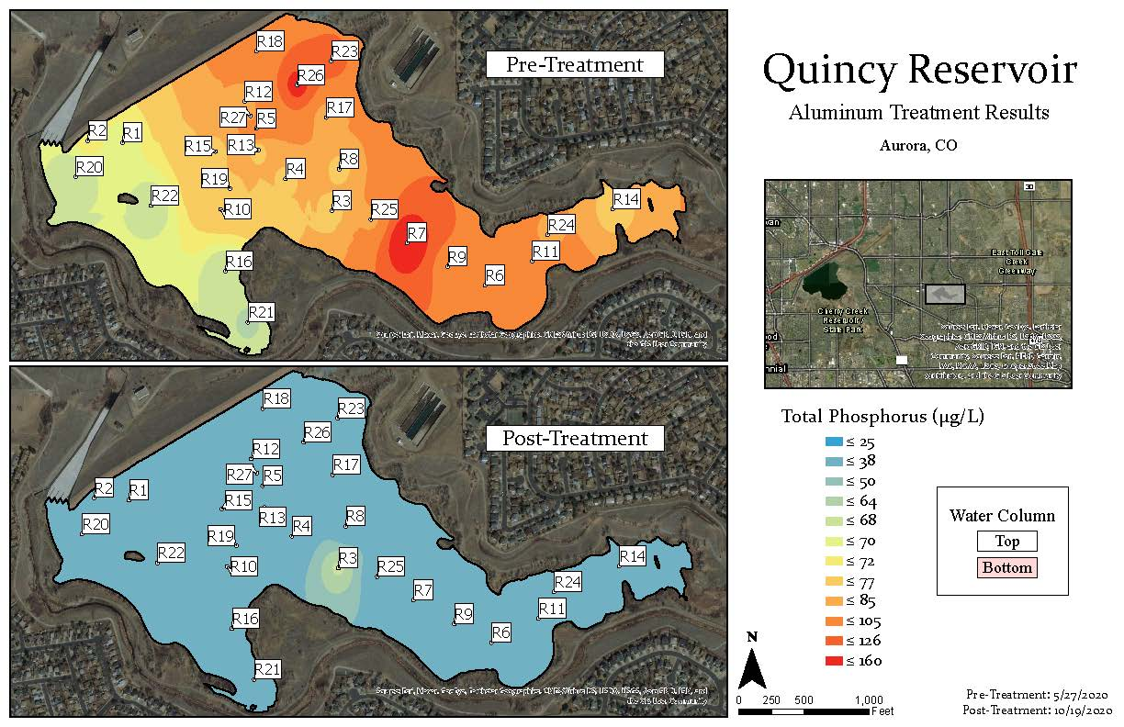

Slide 18
Alum Permit
CDPHE issued the permit!
First of it’s kind, on this scale, in Colorado.
Required aluminum, pH, sulfate and flow during application at each acre on the grid or 128 samples.
Also required aluminum, sulfate and pH on two subsequent sample sets.
Data reported via net-DMR as an aggregate
Also required public outreach, all data and a report

Slide 20
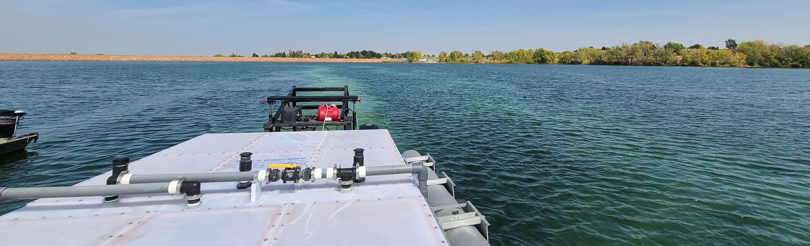
Alum
Two products were used for the project:
aluminum sulfate (alum)
sodium aluminate
  buffer to maintain pH between 6.0 and 8.0
  the total aluminum concentrations within the water column rapidly combine with available phosphorus. However, the alum reaction in water also releases free hydrogen which lowers pH below the 6.0 threshold needed to produce a stable floc.
  it is essential to add a buffering agent, sodium aluminate, to maintain the pH required for the proper treatment reaction to occur.

Slide 21
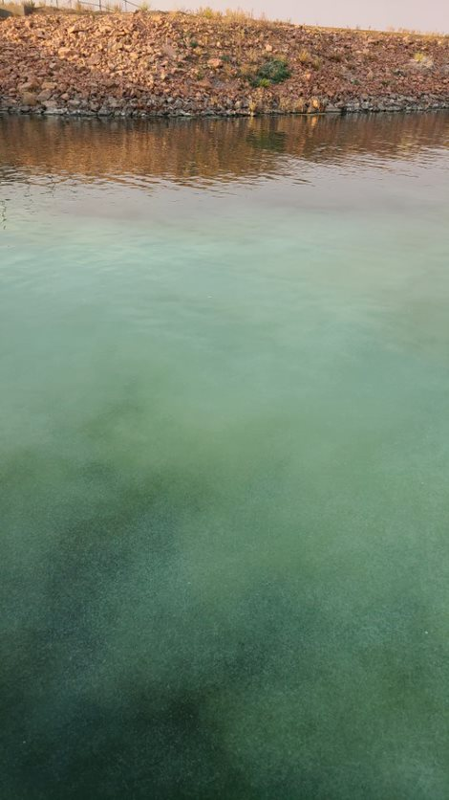
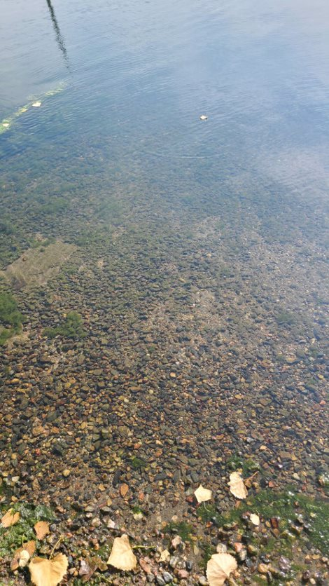
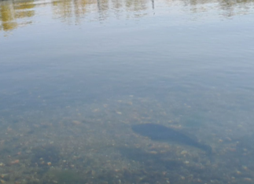

Slide 26
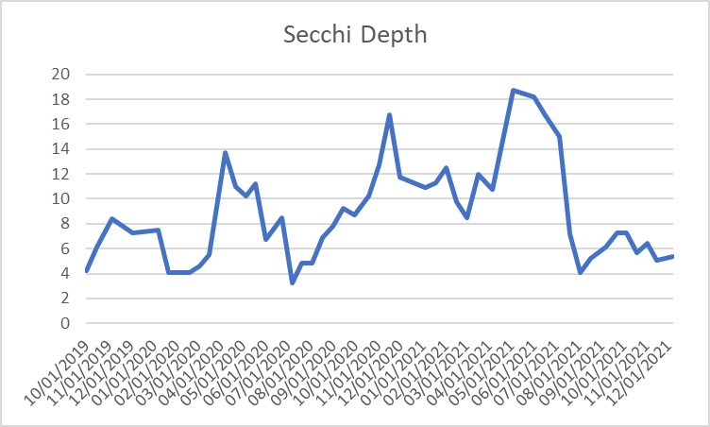
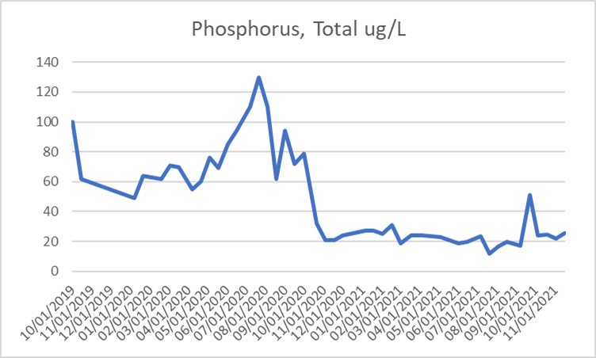
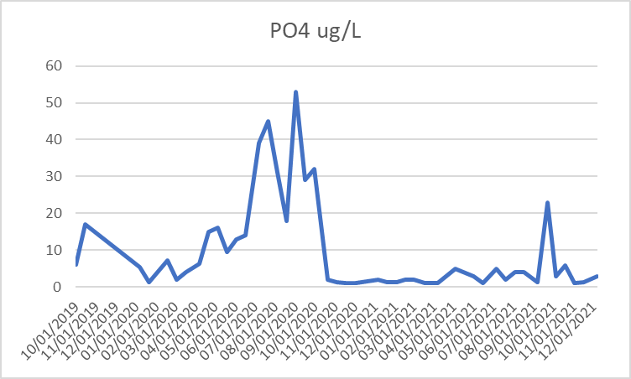

Slide 27
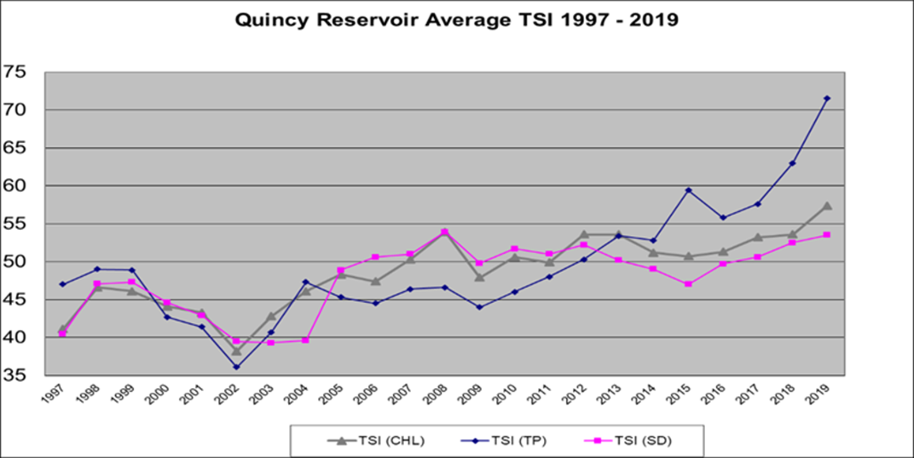
TSI - before

Slide 28
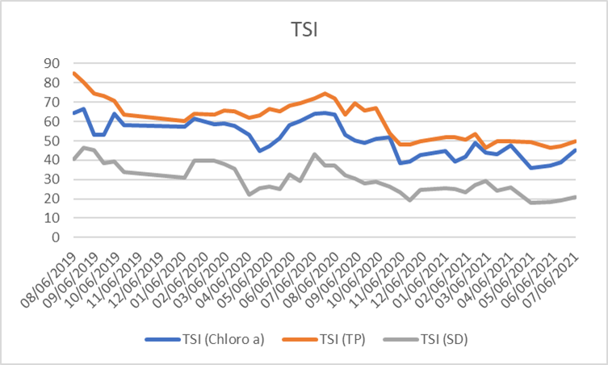
TSI - After

Slide 29
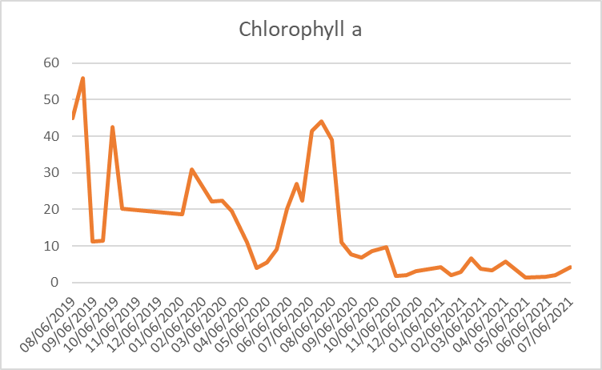
Chlorophyll a
2015 | 2016 | 2107 | 2018 | 2019 | 2020 | 2021
10.7 | 11.7 | 19.6 | 15.4 | 26.2 | 17.3 | 3.4

Slide 30
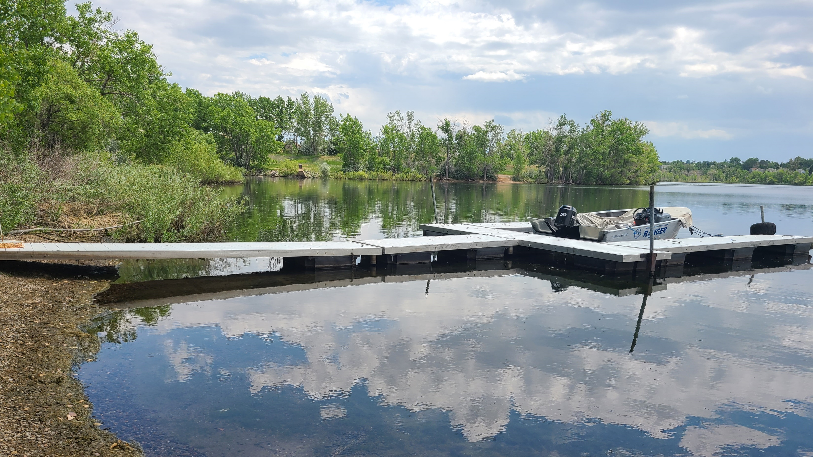

Slide 31
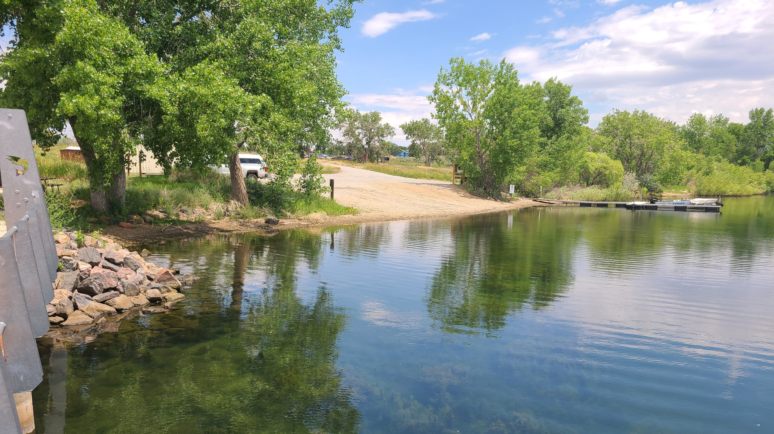

Slide 32
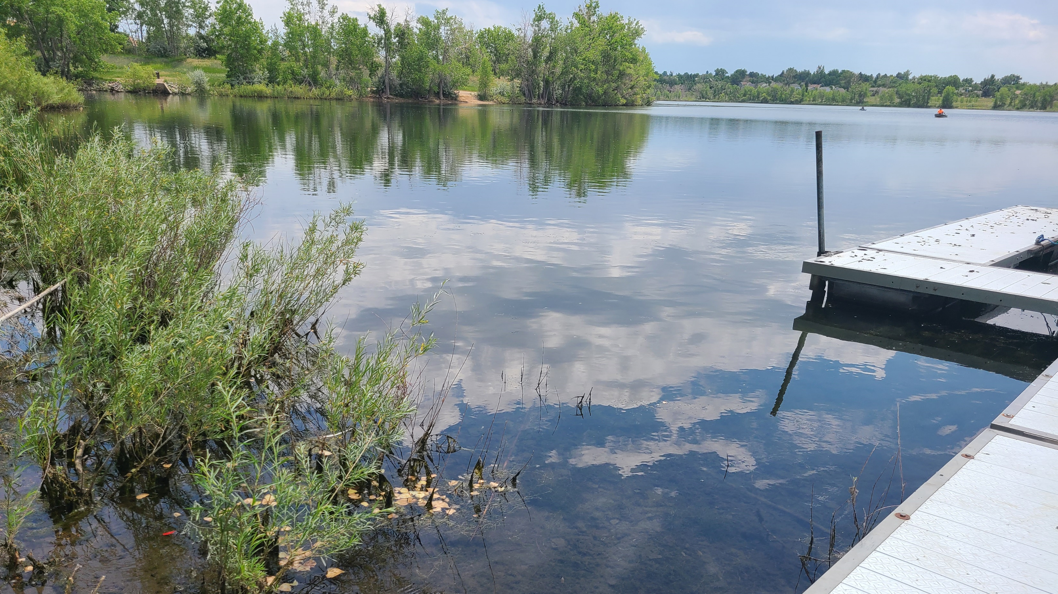

Slide 33
