Slide 1
547 µg/L TP – Barr Lake Summer Average (2003-2007)
92% Phosphorus Loading Reduction to Barr Lake to meet pH/DO TMDL
98+% Phosphorus Loading Reduction to meet Nutrient Standards
100 µg/L TP Summer Maximum
~ 36 µg/L TP Summer Average
376 µg/L TP – Barr Lake Summer Average (2022)

Slide 2
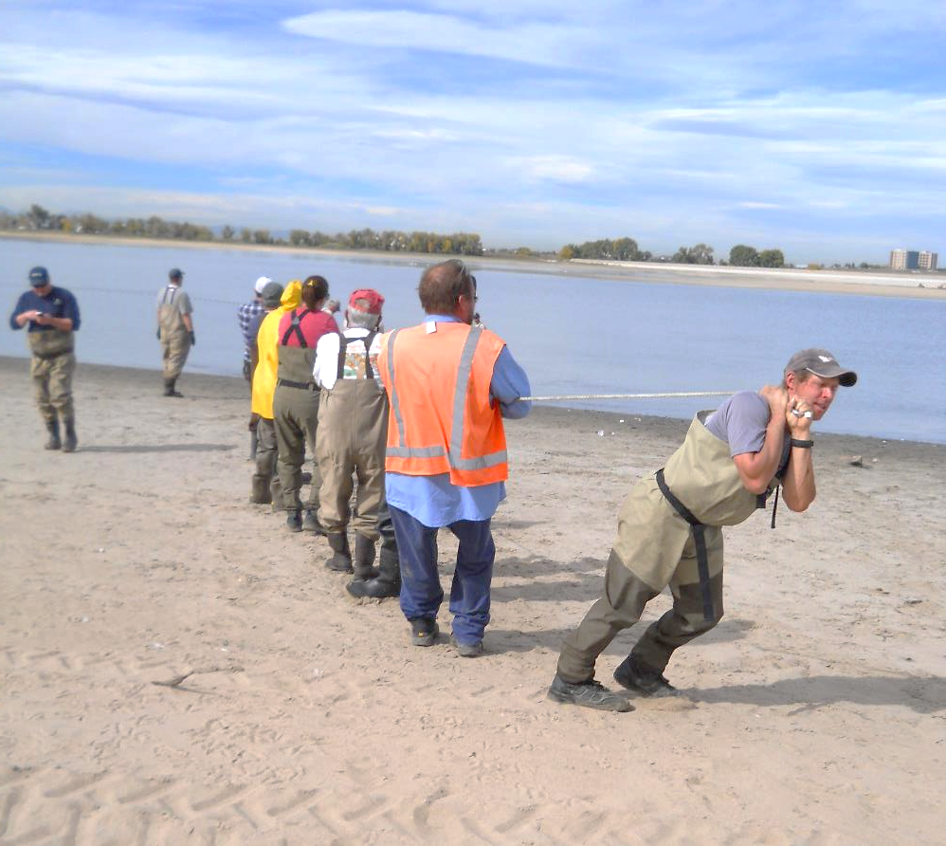
Since 2014
8,880 carp removed
73,300 pounds of carp
211 pounds of org-P
2,000+ pounds of P prevented

Slide 3
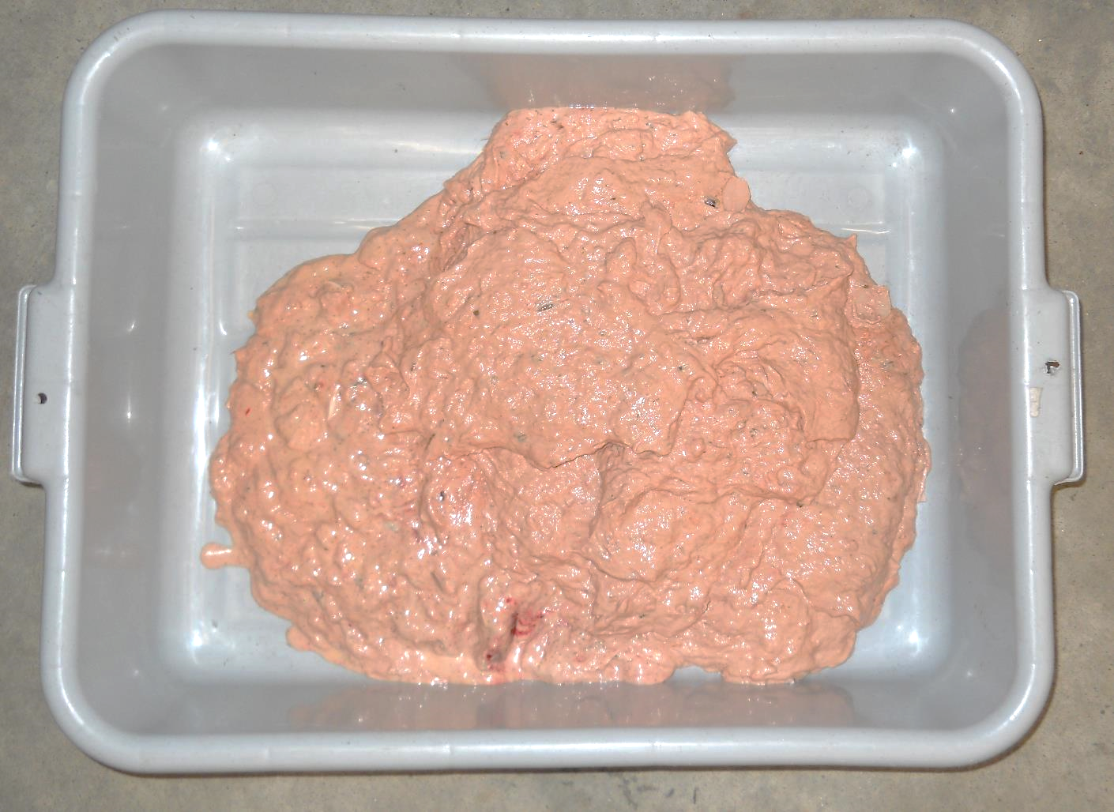

Slide 4
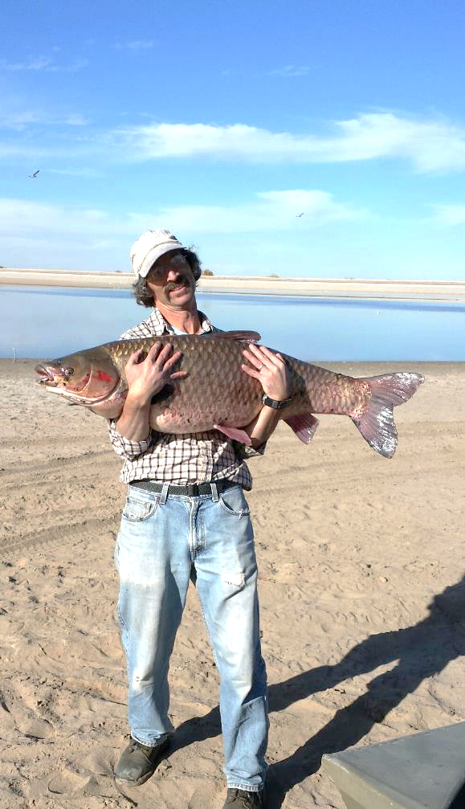
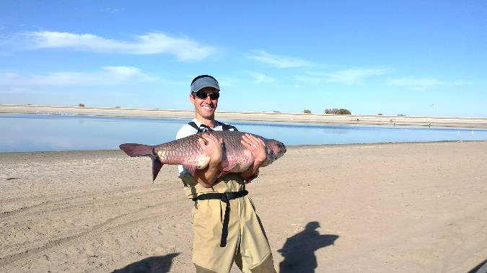
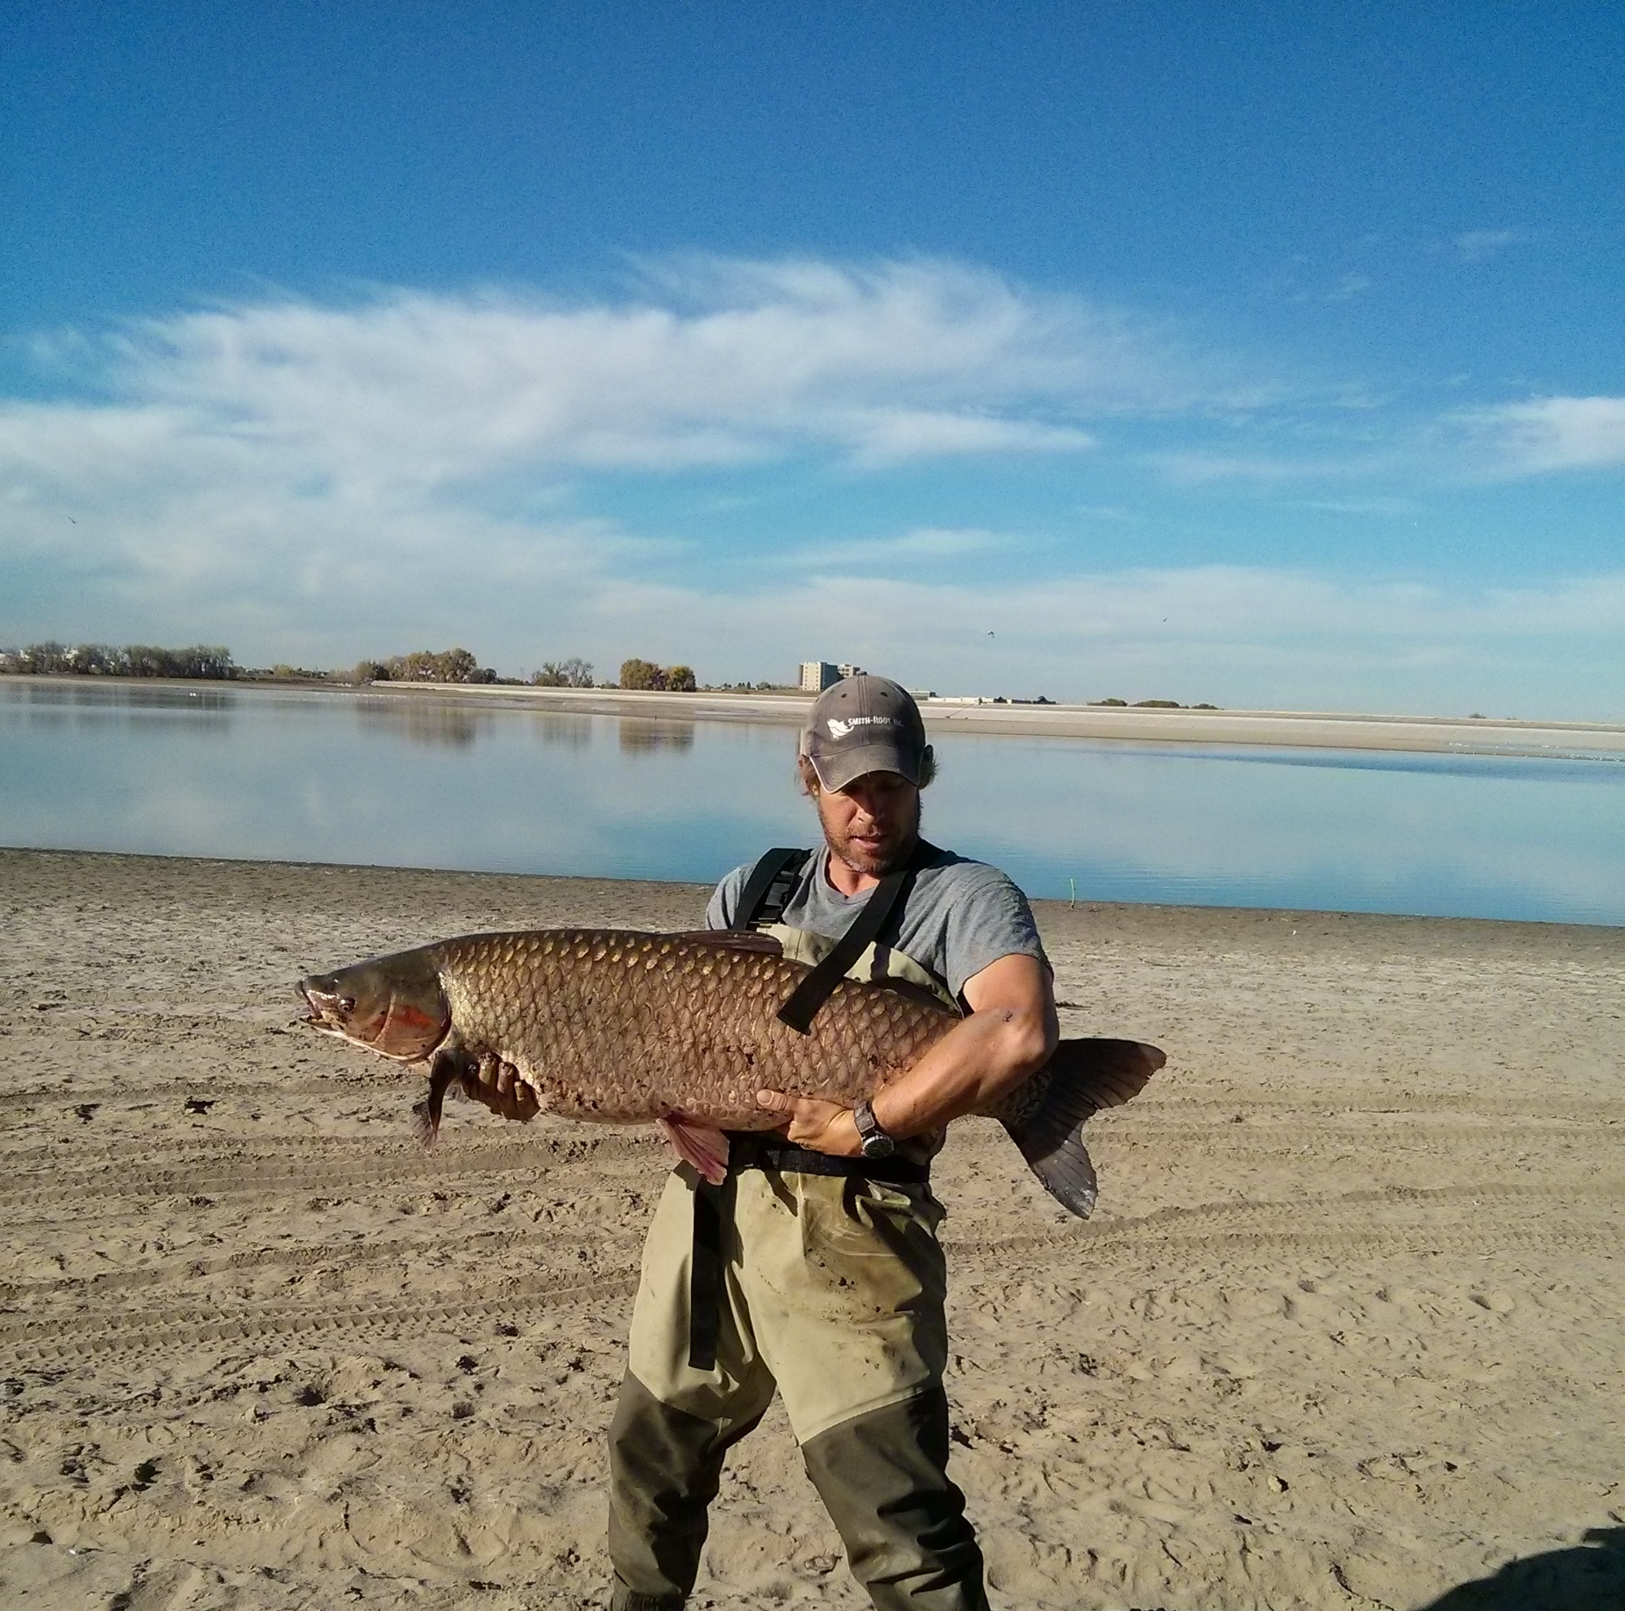
Carp Hugging Program

Slide 5
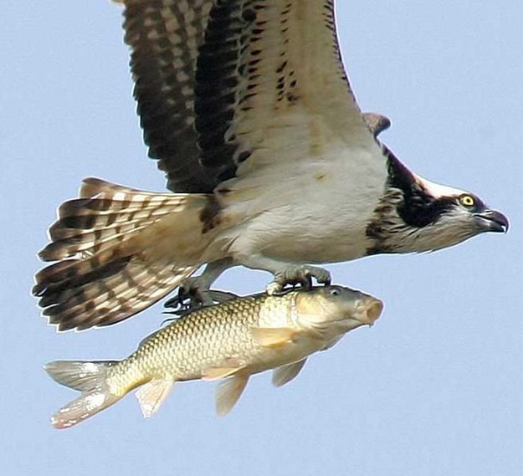

Slide 6
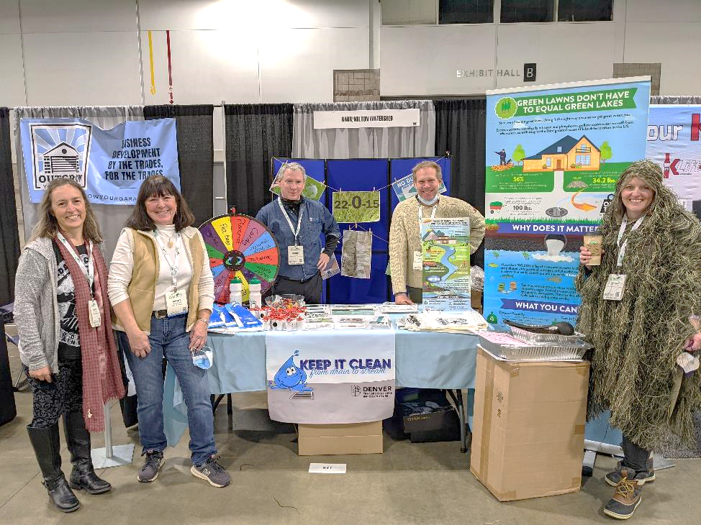
Lawn Fertilizers

Slide 7
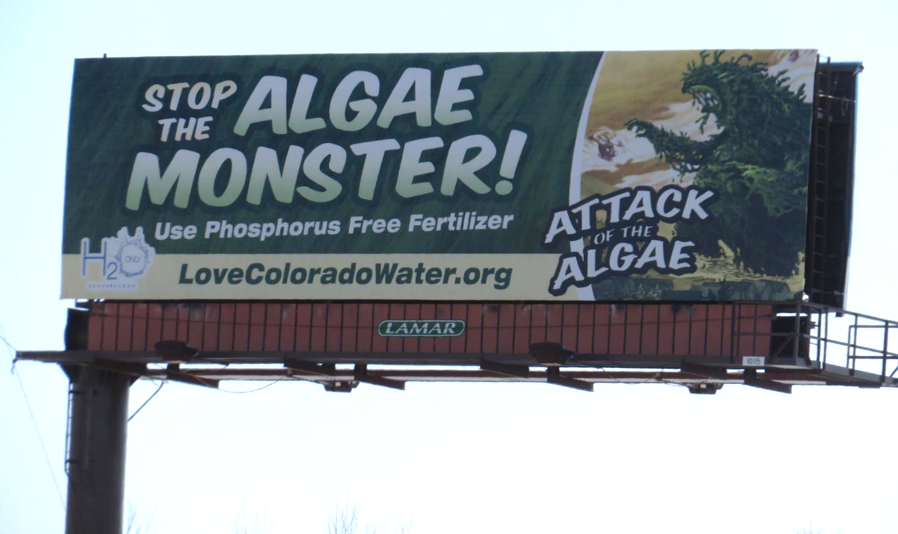
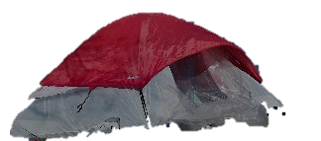

Slide 8

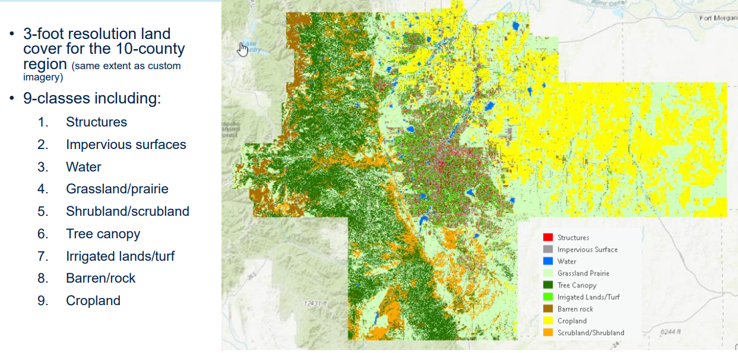

Slide 9
Englewood (6.63 sq. miles)
42% Impervious Surface
22% Turf
17% Structures
13% Tree Canopy
3% Barren Land
1% Natural
1% Water

Slide 10





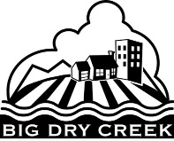



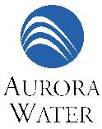





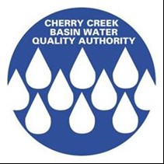




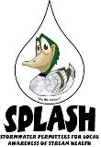






Highlights
Average Turf coverag - 19%
LIRF – 32-82% of summer baseflows are from watered lawns (Aditi Bhaskar, 2021)
38% of lawn fertilizers available have P
26 Coalition Members
Water 22’ Campaign Efforts
Coors Field uses P-free fertizers

Slide 11
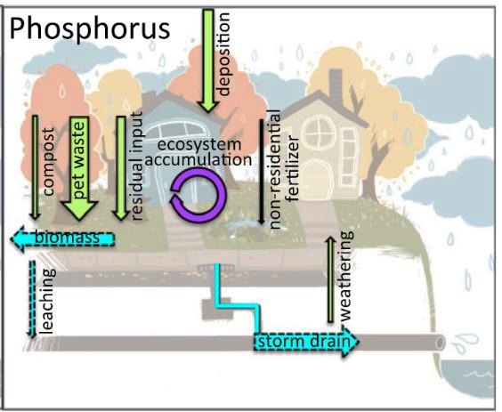
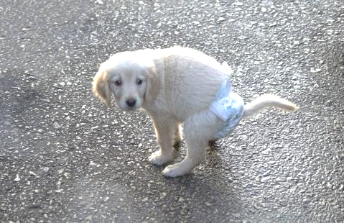



(Minnesota Study)

Slide 12
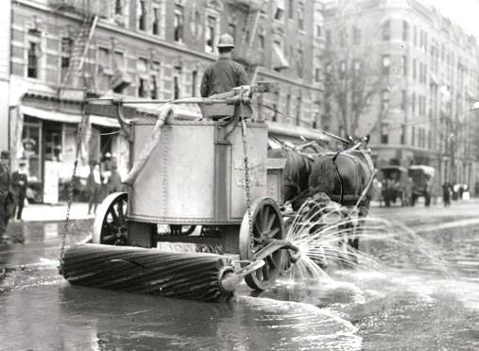
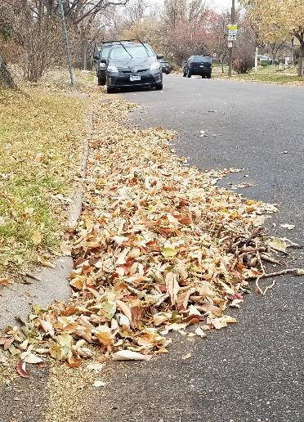
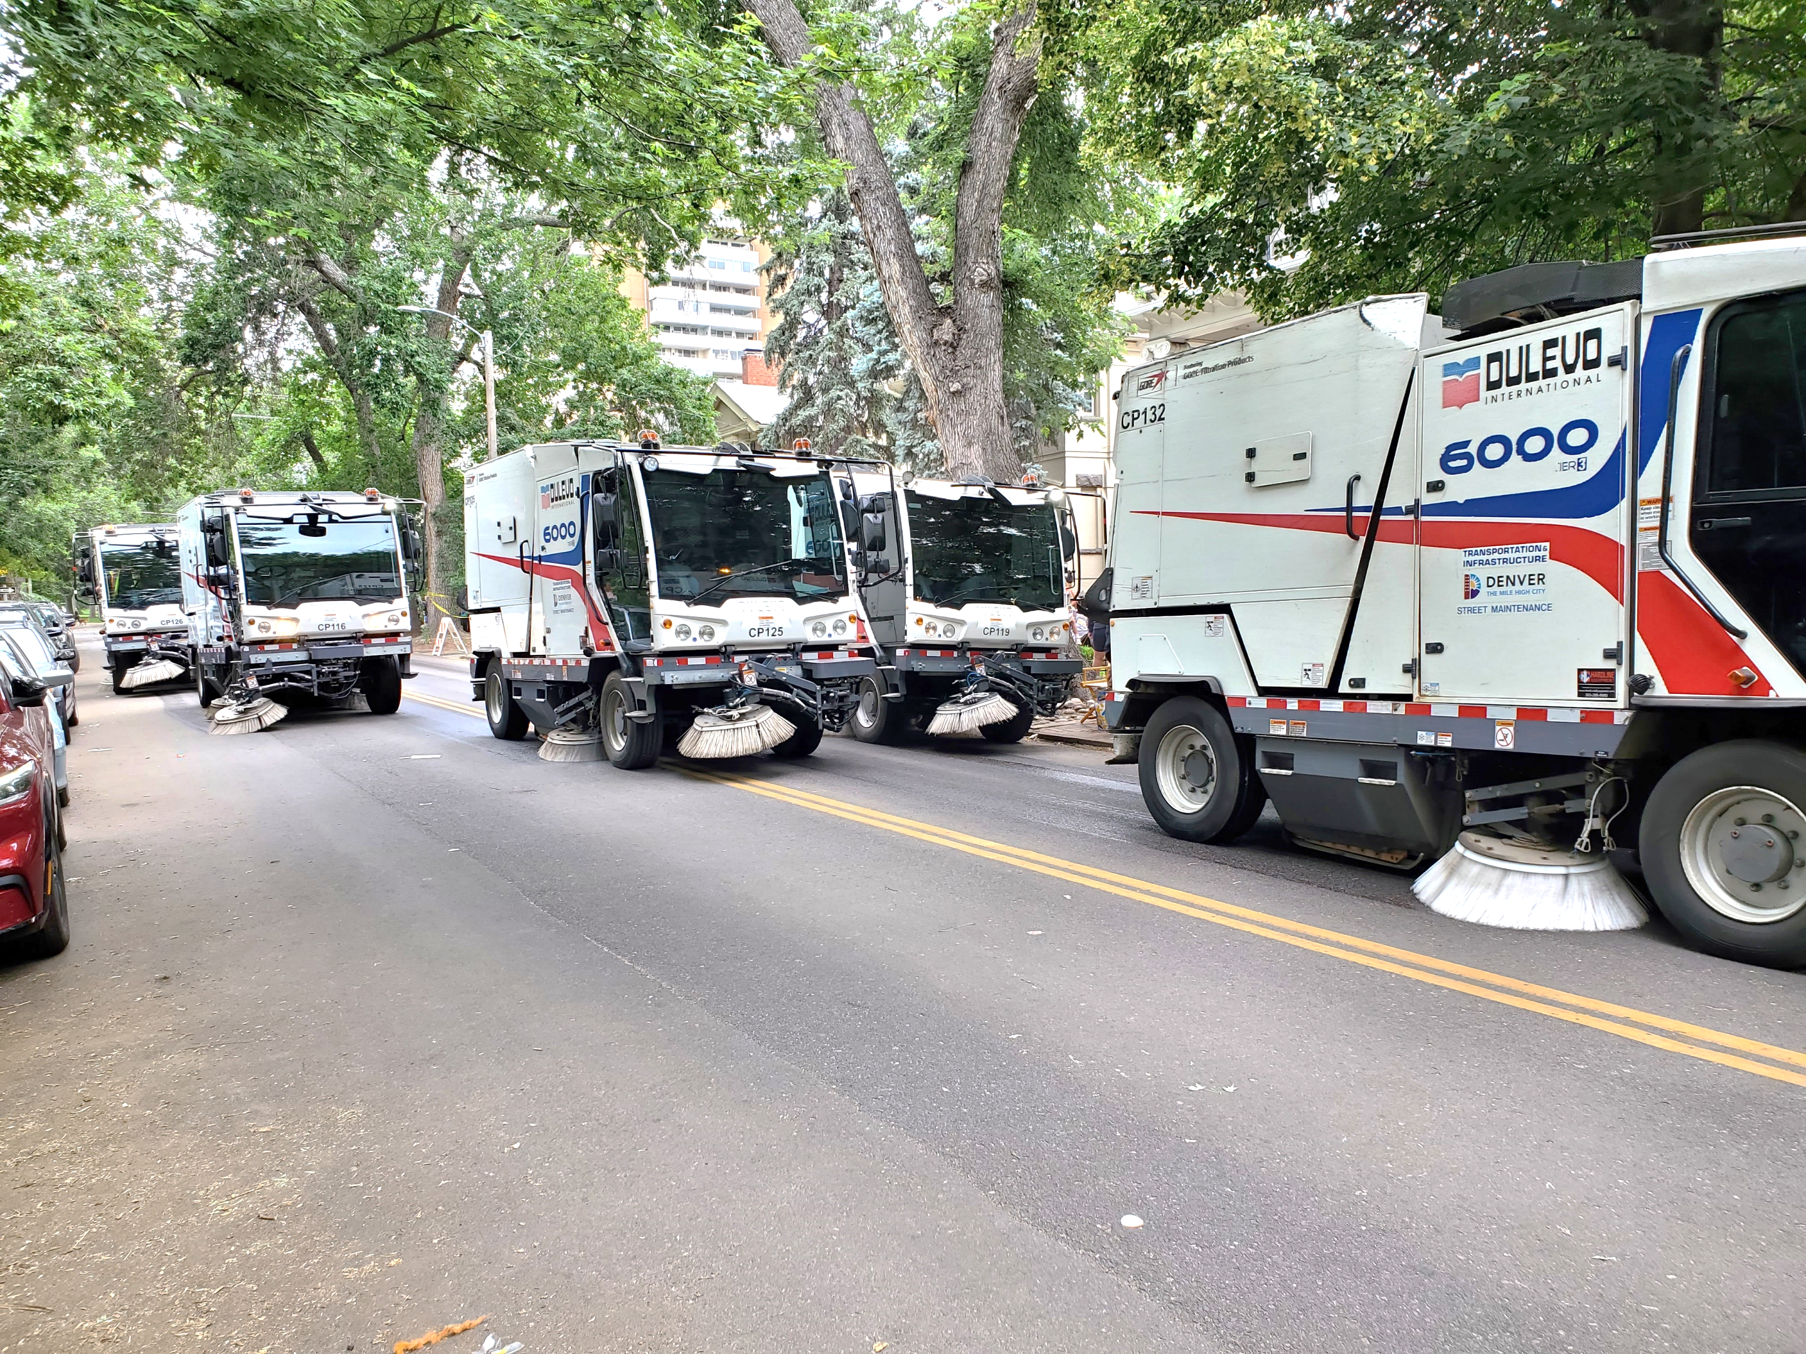
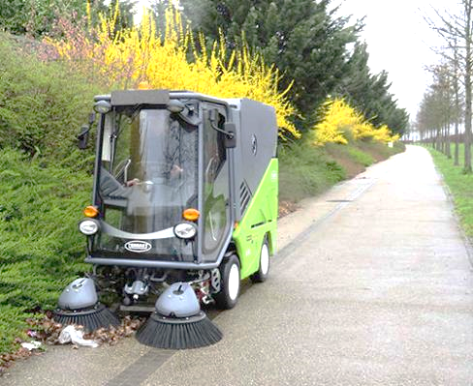
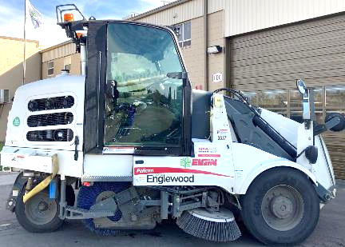
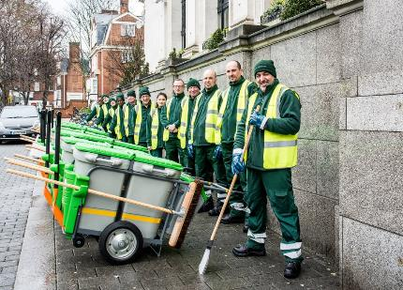
Street Sweeping is the Future

Slide 13
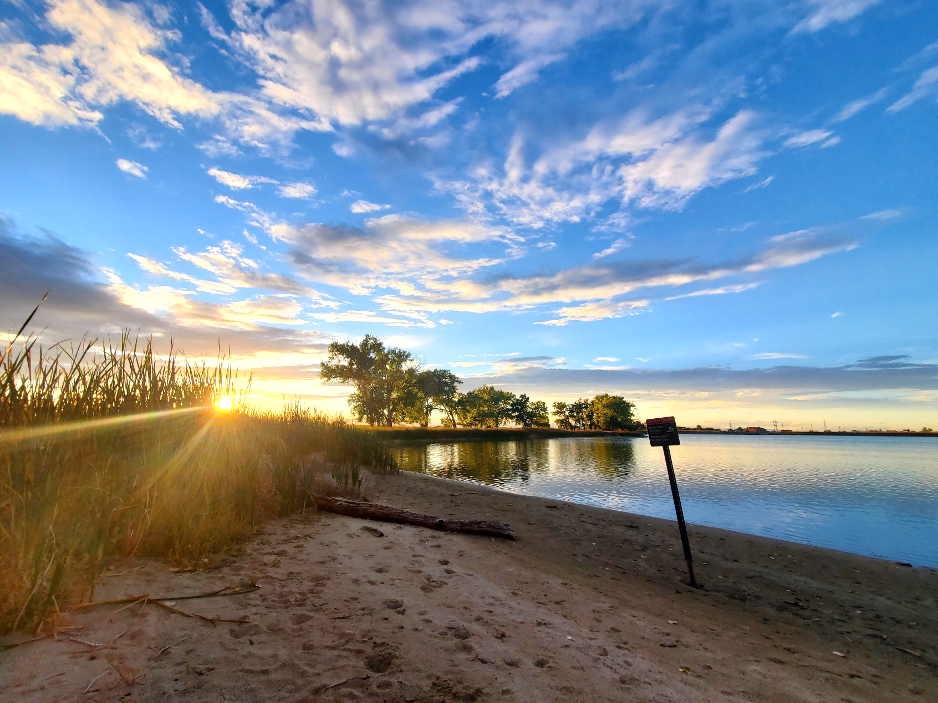
Thanks for your time

