Slide 1
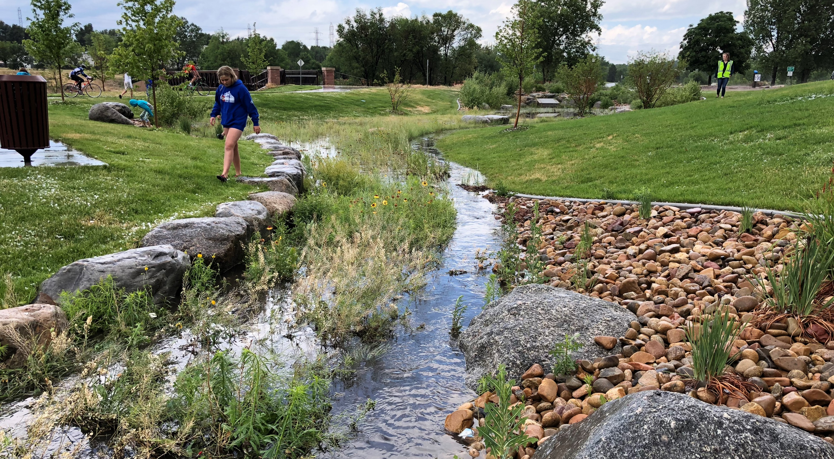


Instream, Wet-weather Nutrient Trends
Holly Piza, P.E., D. WRE
October 6, 2022

Slide 2
Background
1998-2018, 20 years of data!
Phase 1 MS4 requirement for instream, wet weather monitoring
JTF = MHFD, Denver, Aurora, and Lakewood
USGS and Colorado DWR streamflow gaging stations
MHFD ALERT rainfall stations
  Stream flow
  Precipitation
Refrigerated autosamplers remotely operated
  24-hour composite water quality sample

Slide 3
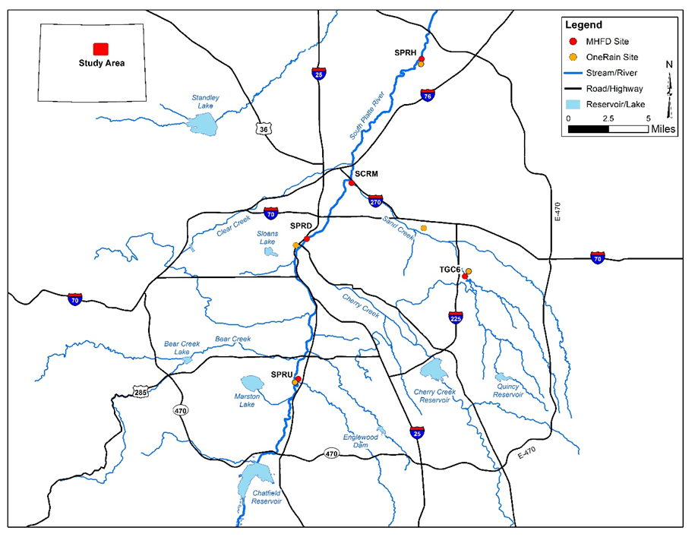
1
Sand
2
TG
3
Notes:
541 composite samples over 20 years of data

Slide 4
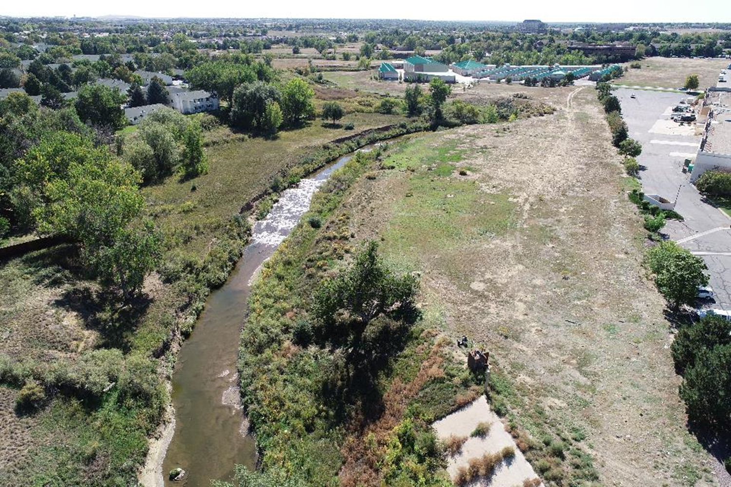
Data Collection
Composite Samples
  Seasonally (Apr-Oct)
  Lab analysis of physicochemical, ions, nutrients, metals, and solids
Trend analysis focused on…
  Conductivity
  Total Suspended Solids
  Total Nitrogen
  Total Phosphorus

Slide 5
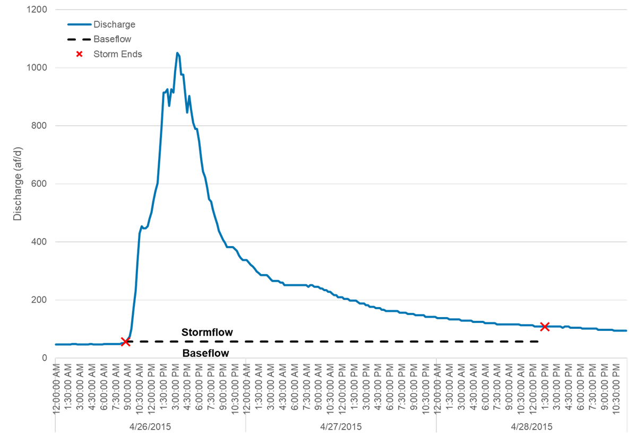
Bounds on Hydrology
  Stormflow = Discharge – Baseflow
Notes:
(SPR) Chatfield Reservoir releases and (Sand) Aurora Water Reuse Facility
Account for changes in baseflow and concentrations

Slide 6
Total Suspended Solids (TSS) Concentrations
3
2
Sand
1

Slide 7
Total Phosphorus Concentrations
3
2
Sand
1

Slide 8
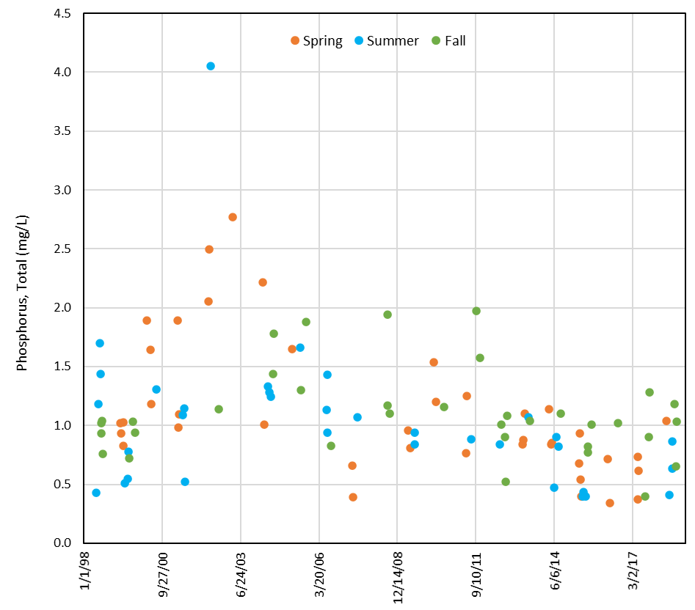
Trend Analysis
South Platte River at Denver

Slide 9
Water Quality Trends
2
TG
1
3
Sand
Water Quality | South Platte River below Union Avenue | South Platte River at Denver | Toll Gate Creek above 6th Avenue | Sand Creek above Burlington Ditch | South Platte River at Henderson
Suspended Solids, Total (mg/L) | X | X | X | ▼ | ▼
Specific Conductance (µS/cm) | ▲ | X | ▲ | ▲ | X
Nitrogen, Total (mg/L) | X | X | X | X | ▼
Phosphorus, Total (mg/L) | X | ▼ | X | X | ▼
▼ Significant decreasing trend
▲ Significant increasing trend
X No trend

Slide 10
Base Flow Hydrology Trend – SPR Denver (2)
No Trend

Slide 11
Base Flow Hydrology Trend – Sand Creek
Significant decrease by 6.5 cfs per year

Slide 12
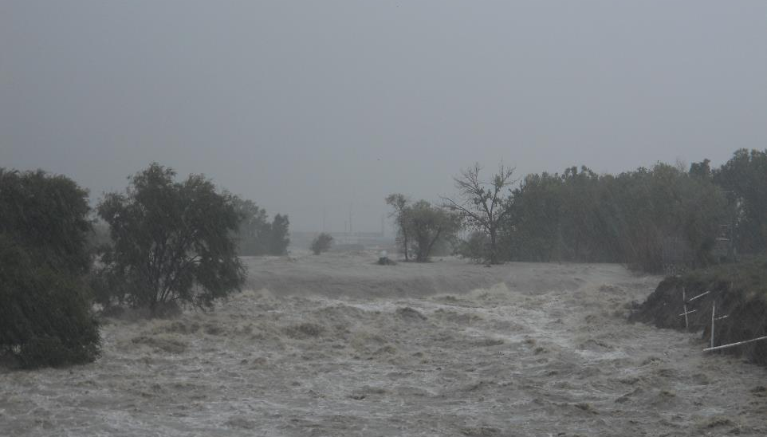
Storm Loads Trend Analysis
Loads

Slide 13
Normalized Loads Pounds per day
South Platte River below Union Avenue
Analyte | No. Storms Samples | Minimum | Max | Mean
Nitrogen, Total | 89 | 48 | 10,698 | 1,613
Phosphorus, Total | 93 | 3 | 3,124 | 316
Total Suspended Solids | 93 | 32 | 2,960,239 | 245,761
South Platte River at Denver
Analyte | No. Storm Samples | Min. | Max | Mean
Nitrogen, Total | 124 | 951 | 76,565 | 11,074
Phosphorus, Total | 126 | 57 | 13,136 | 1,995
Total Suspended Solids | 128 | 12,233 | 10,984,394 | 1,105,888
Sand Creek above Burlington Ditch
Analyte | No. Storms Samples | Min. | Max | Mean
Nitrogen, Total | 88 | 169 | 38,388 | 4,221
Phosphorus, Total | 92 | 28 | 14,862 | 1,198
Total Suspended Solids | 94 | 2,536 | 10,568,654 | 834,797
South Platte River at Henderson
Analyte | No. Storms Samples | Min. | Max | Mean
Nitrogen, Total | 91 | 1,826 | 103,730 | 23,253
Phosphorus, Total | 95 | 282 | 23,398 | 4,709
Total Suspended Solids | 97 | 7,530 | 19,761,101 | 2,040,847

Slide 14
Total Suspended Solids
Loads
3
2
Sand
1

Slide 15
Total Phosphorus
Loads
3
2
Sand
1

Slide 16
Trend Analysis Summary
2
TG
1
3
Sand
Water Quality | South Platte River below Union Avenue | South Platte River at Denver | Toll Gate Creek above 6th Avenue | Sand Creek above Burlington Ditch | South Platte River at Henderson
Suspended Solids, Total (mg/L) | X | X | X | ▼ | ▼
Specific Conductance (µS/cm) | ▲ | X | ▲ | ▲ | X
Nitrogen, Total (mg/L) | X | X | X | X | ▼
Phosphorus, Total (mg/L) | X | ▼ | X | X | ▼
Discharge |  | South Platte River at Denver | Sand Creek above Burlington Ditch | Sand Creek above Burlington Ditch | South Platte River at Henderson
Discharge (cfs) | X | X | X | ▼ | X
Loads |  | South Platte River at Denver | Sand Creek above Burlington Ditch | Sand Creek above Burlington Ditch | South Platte River at Henderson
Suspended Solids, Total (#/day) | X | X | X | ▼ | X
Nitrogen, Total (#/day) | X | X | X | X | X
Phosphorus, Total (#/day) | X | X | X | ▼ | X
▼ Significant decreasing trend
▲ Significant increasing trend
X No trend

Slide 17

Thank You!

