Slide 1
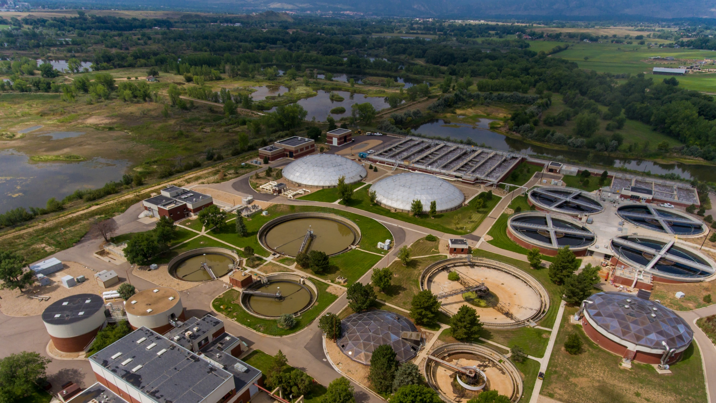
Please place all content on slides
It’s All About Carbon:
Nutrient Removal at the City of Boulder
PowerPoint will be formatted after all information has been submitted
Cole Sigmon, PE, CWP
Wastewater Treatment Manager
Utilities Department, City of Boulder

Slide 2
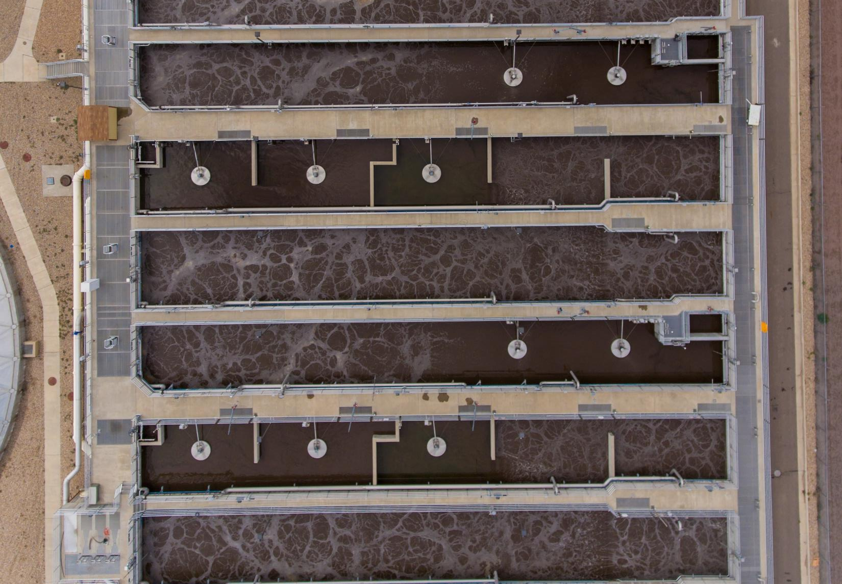
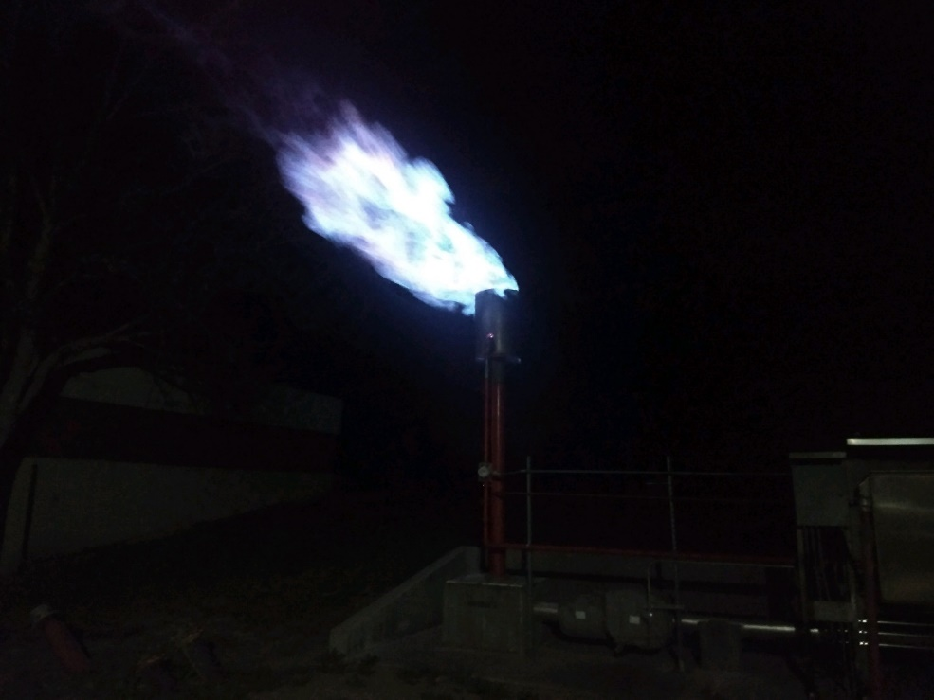
Carbon Case Studies
Carbon Management
Rethinking waste: External Carbon
Shopping local: Carbon Balance

Slide 3
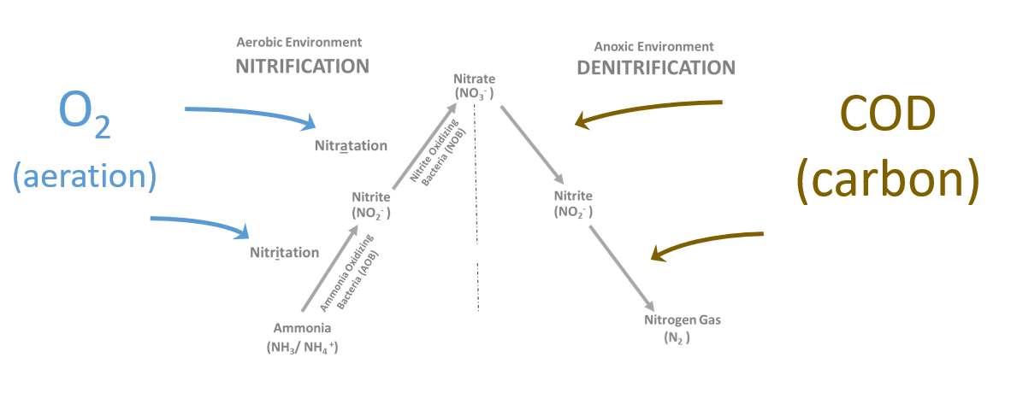
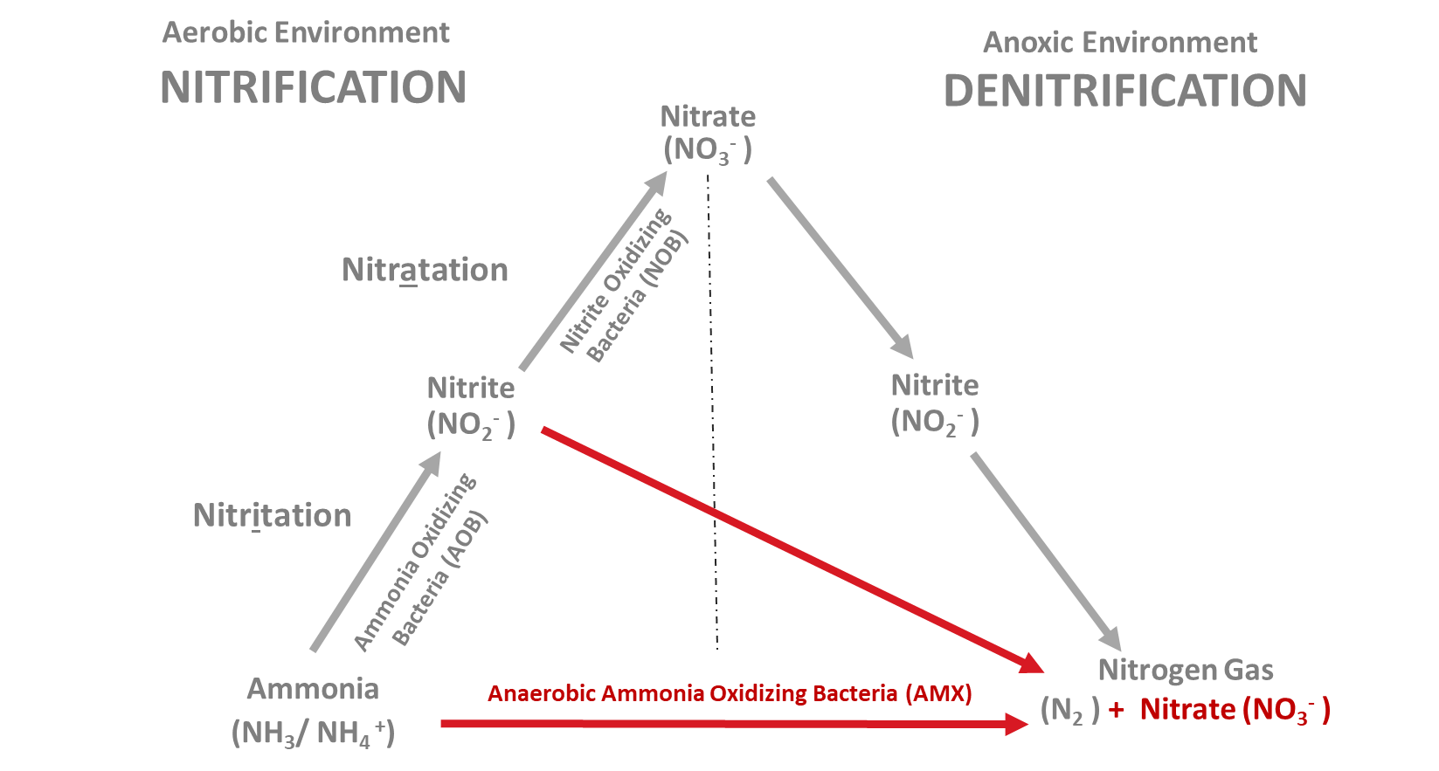
Rethinking “Waste” – External Carbon Carbon and Denitrification
O₂
_{(aeration)}
COD (carbon)

Slide 4
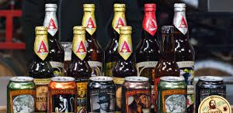
Not all Carbon
Total COD
Biodegradable COD
Readily Biodegradable (soluble)
NB Soluble
NB Particulate
Slowly Biodegradable (particulate)
Nonbiodegradable COD
Complex
VFA
Colloidal
Particulate
Is Created Equally

Slide 5
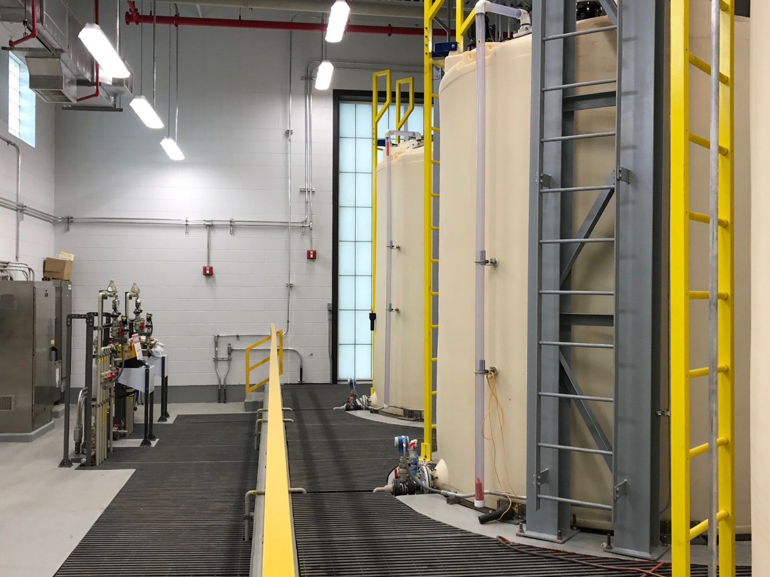
Rethinking “Waste” – External Carbon External Carbon Storage and Feed Facility

Slide 6
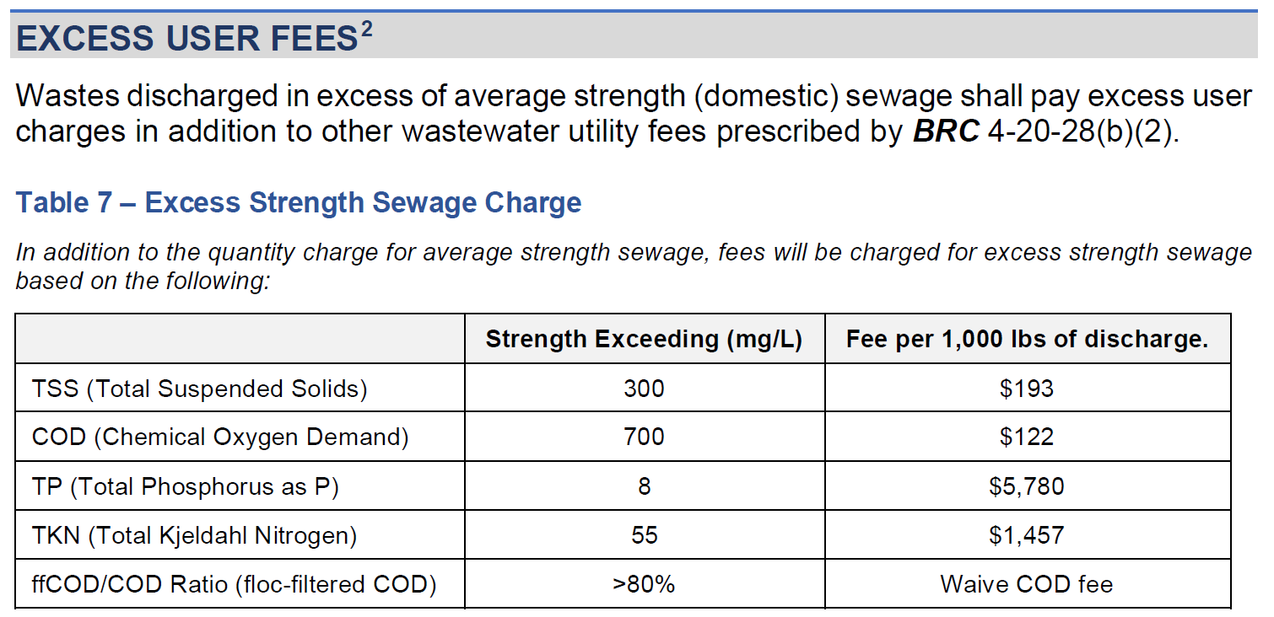
Rethinking “Waste” – External Carbon BOD Excess User Fees Reimagined

Slide 7
Beer-Enhanced Nitrogen Removal Nitrogen Performance
External Carbon Addition

Slide 8
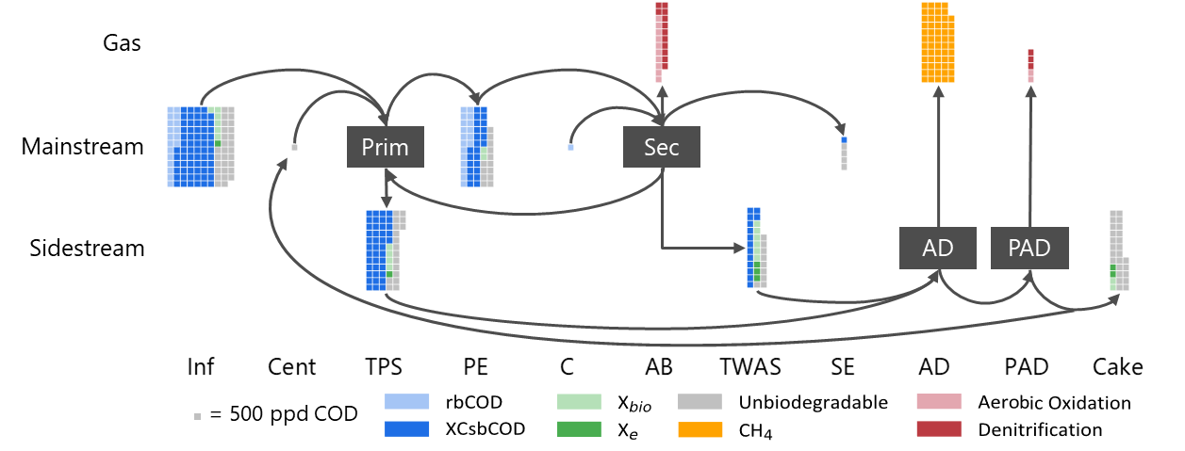
Shopping Local – Carbon Balance

Slide 9
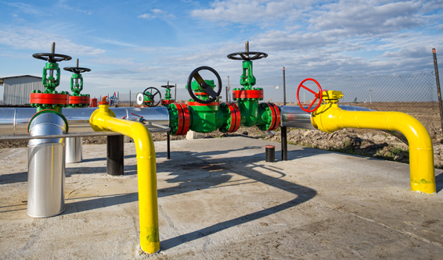
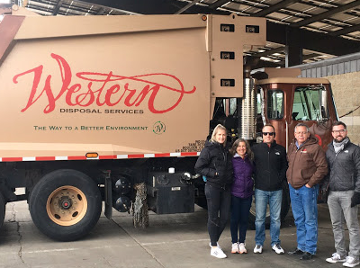
Energy Recovery – Biogas to RNG Project Overview
Digester gas production
Biogas treatment system
Pipeline injection and conveyance
End use as vehicle fuel by Western Disposal

Slide 10
Summary
Not all carbon is created equally
Rethink “waste” BOD
Shop Local

Slide 11
Please place all content on slides
PowerPoint will be formatted after all information has been submitted
sigmonc@bouldercolorado.gov

Slide 12
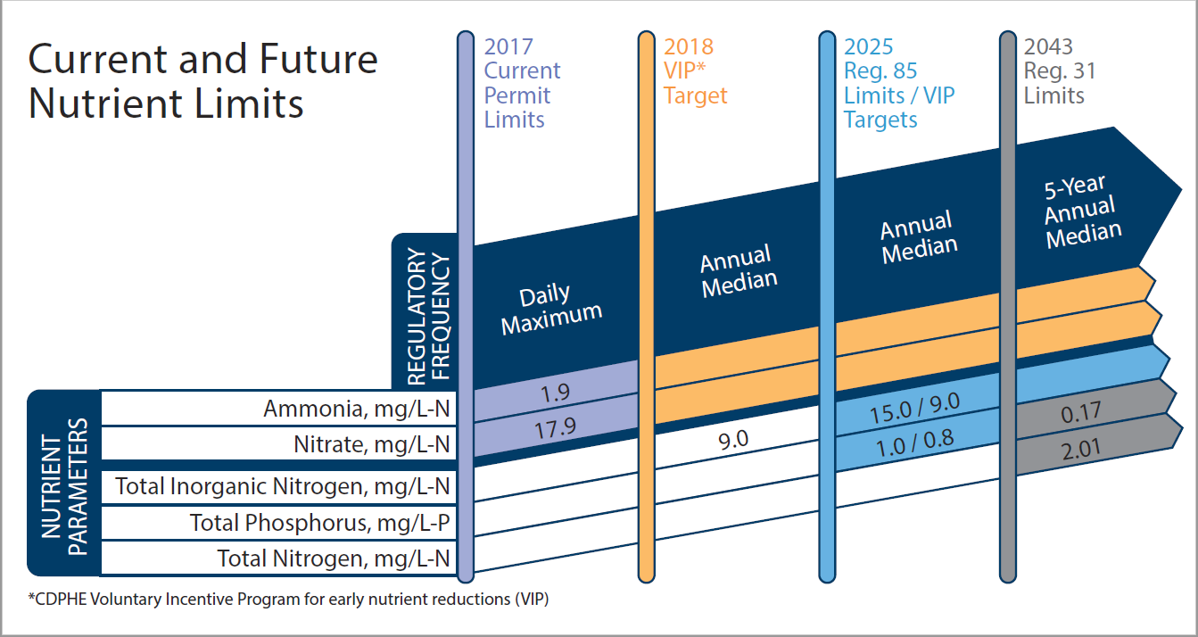

Slide 13
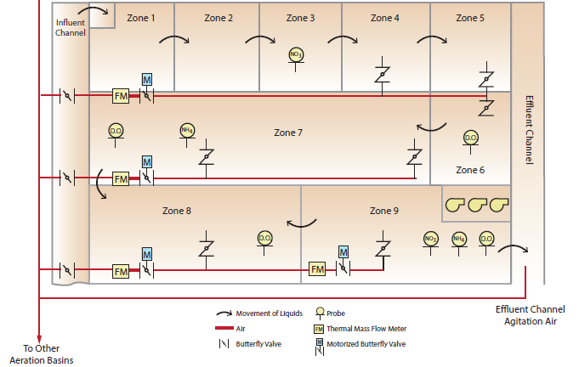
Rethinking “Waste” – External Carbon External Carbon Storage and Feed Facility
Dosing to post-anoxic zone
Nitrate pacing
Operational flexibility

Slide 14
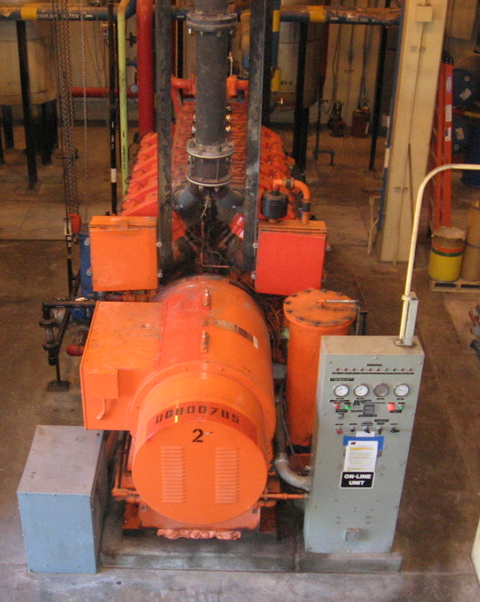
Energy Recovery – Biogas to RNG Background
Anaerobic Digesters process municipal sludge
CoGen System from 1986 was failing
New CoGen not economically viable
RNG technology and subsidy intersection
Onsite use not possible – City going to EVs

