Slide 1
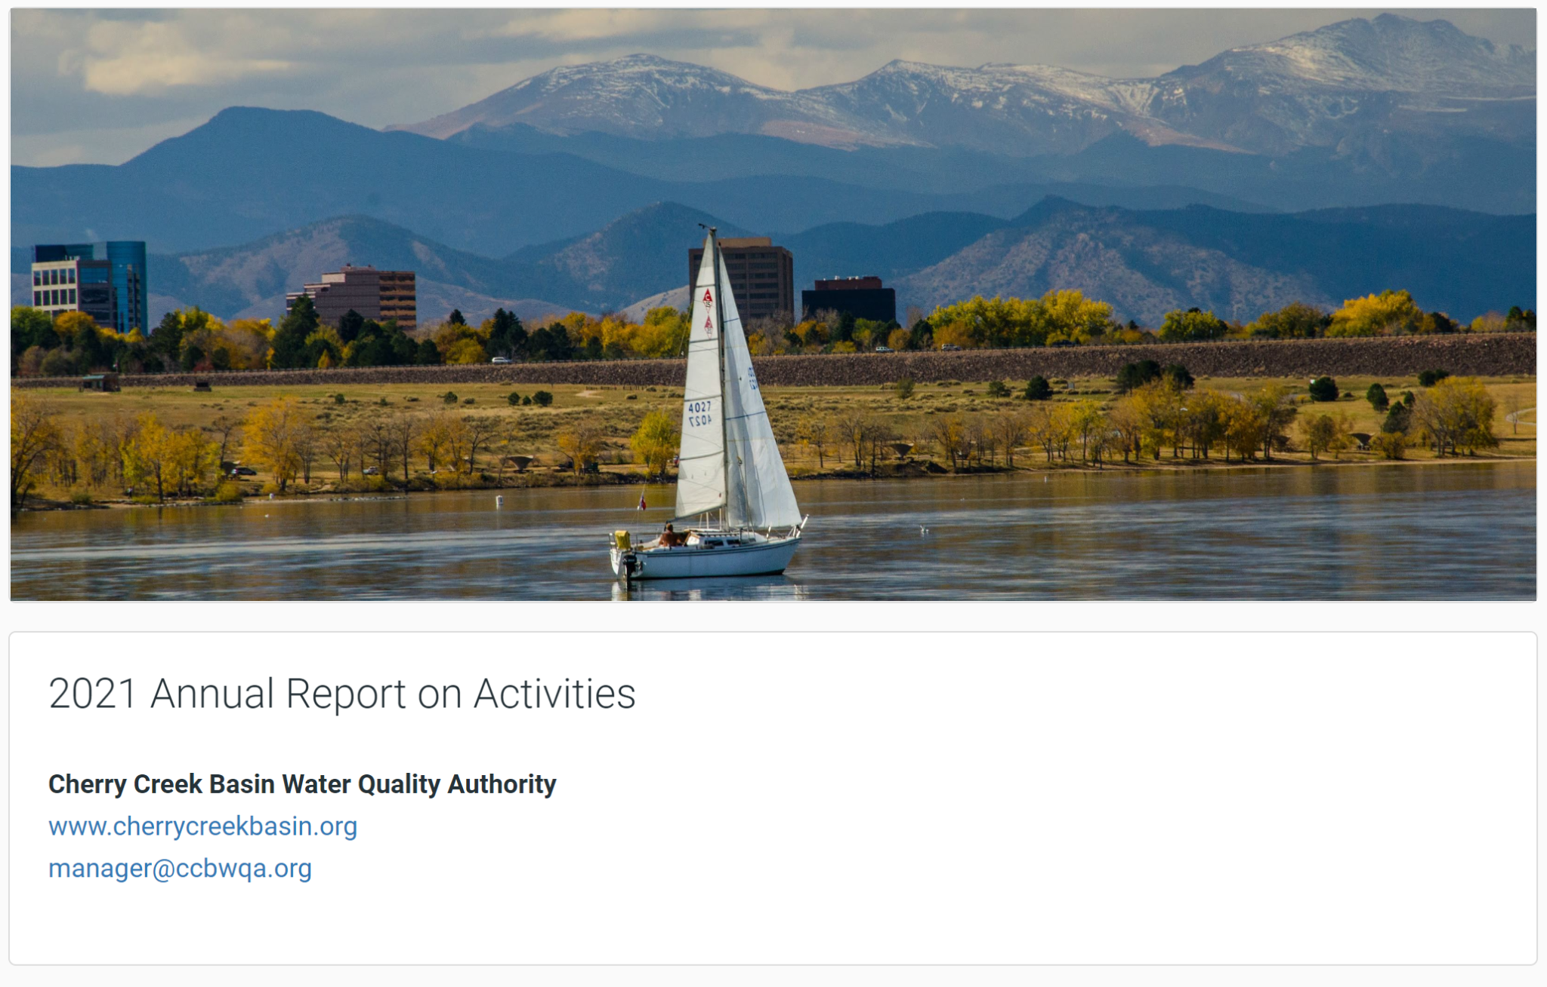




Cherry Creek Reservoir - No Silver Bullet
Jane Clary
Wright Water Engineers, CCBWQA
Erin Stewart
LRE Water, CCBWQA
Notes:
Jane

Slide 2
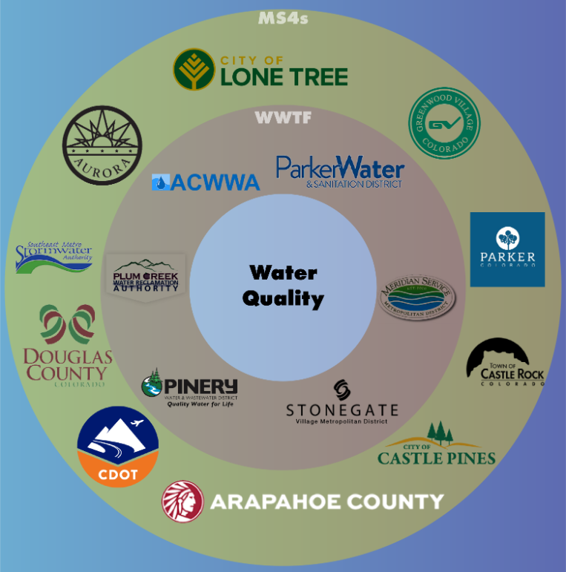
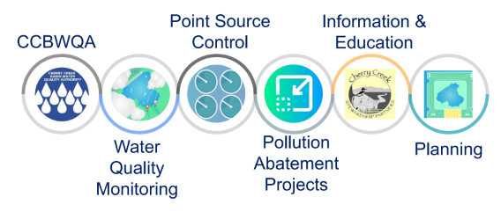
Cherry Creek Basin Water Quality Authority Activities and Water Quality Partners
Notes:
Jane

Slide 3
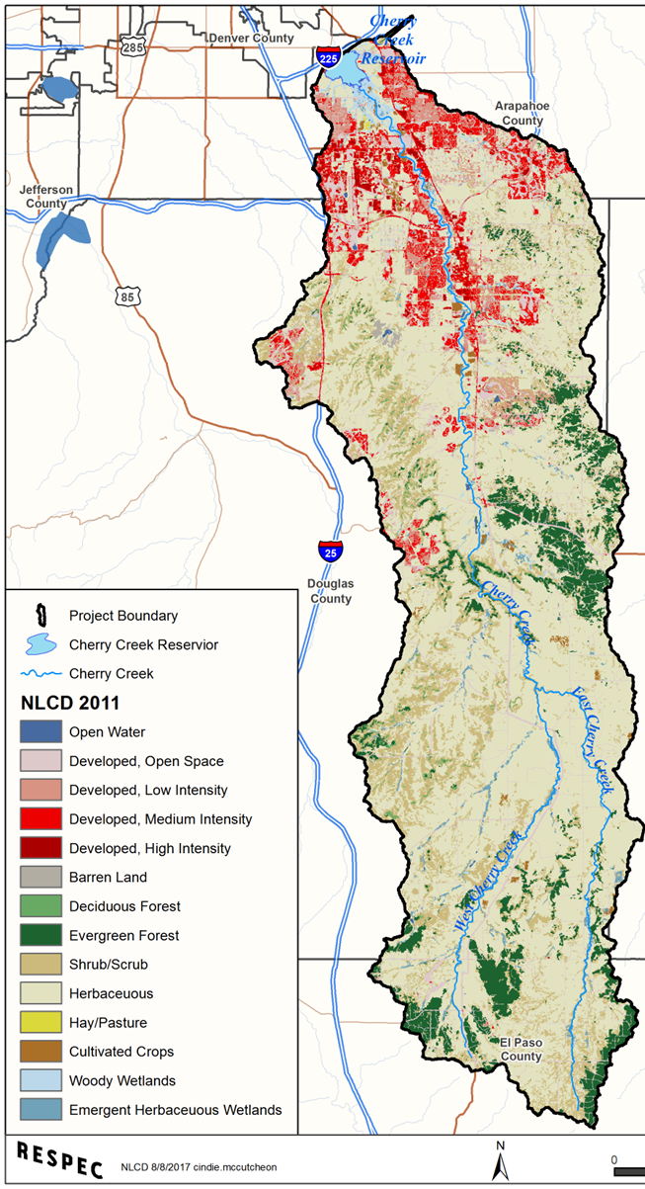
Background
Reservoir
Cherry Creek Reservoir Tributary Area: ~ 390 sq. miles with 600 miles of creeks and streams
Reservoir: Flood control, Walleye fishery, recreation
Regulation 72 includes requirements for:
  Point Sources/Wastewater (72.4)
  Nonpoint Sources & ISDSs (72.6)
  Stormwater (72.7)
  Nutrient Monitoring (72.8)
  Reporting (72.9)
Reg. 38: chlorophyll-a standard of 18 ug/L, with allowed exceedance 1X/5 years
Reg. 72 focuses on nutrient controls (particularly phosphorus) to meet chlorophyll-a standard
Aurora
El Paso County
Notes:
Jane

Slide 4
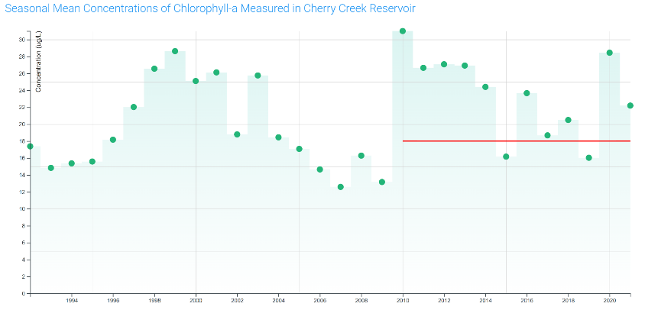
Chlorophyll-α Standard Not Currently Attained
30
20
Chl-a Std: 18 µg/L
12
1992
2010
2021
Notes:
Erin to do slides 4-15

Slide 5
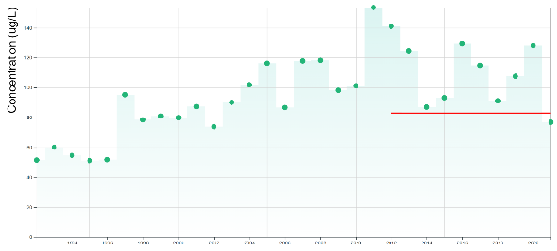
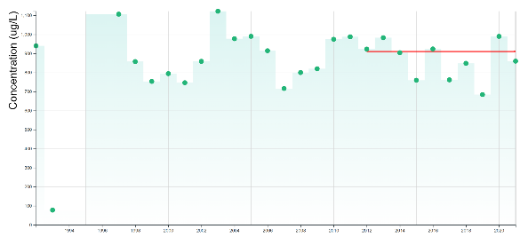
Nutrients
Total Phosphorus
Seasonal means for nutrients in CCR from the photic zone are measured from July-Sept.
Total phosphorus only met the interim lake nutrient criteria in 2021 since 2012.
Total nitrogen met the interim lake criteria 6 years since 2012.
“Old” Interim Criteria (87 ug/L)
1992
2021
“Old” Interim Criteria (910 ug/L)
Total Nitrogen
Notes:
Erin (45 sec)

Slide 6
Cherry Creek Reservoir Inflows Average Loads and Concentrations (from HSPF Model)
Reservoir Inflows from HSPF Model
Baseline Model Results:
Flow: Average 19,500 AF/yr
TP: 10,800 lbs/yr, 0.205 mg/L
TN: 65,400 lbs/yr, 1.23 mg/L
TSS: 3,200 tons/yr, 123 mg/L

Slide 7
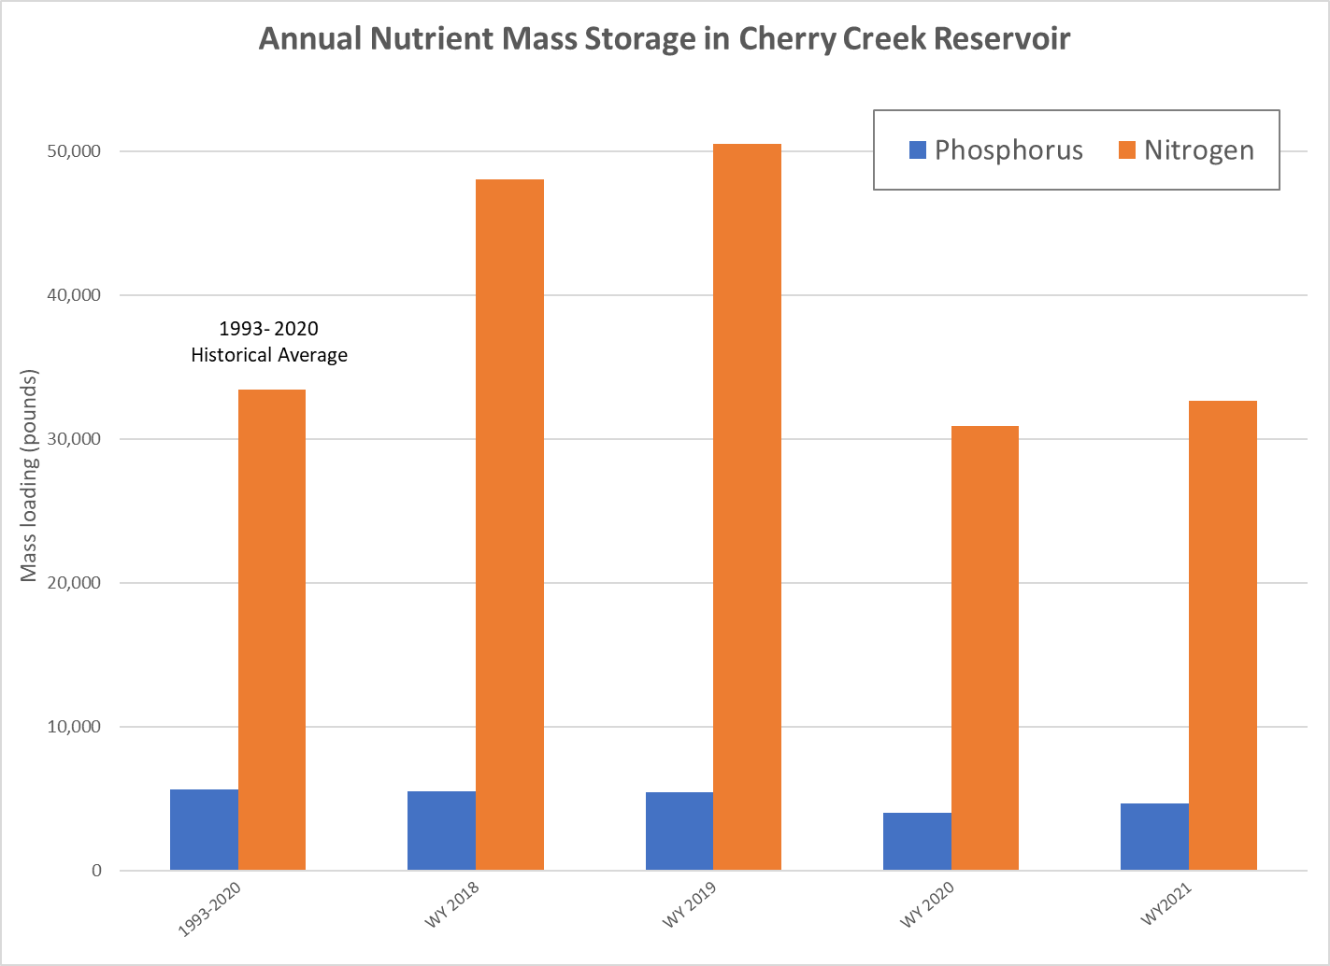
Other Metrics?
Many factors affect annual mass storage:
Total inflows
Total outflows Precipitation Internal loading
Other factors
1993-2020
WY 2018
WY 2019
WY 2020
WY 2021
Notes:
Erin (45 sec)

Slide 8
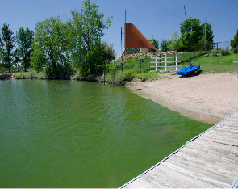
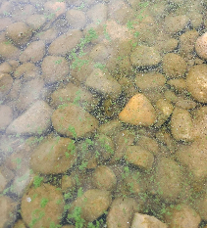
Phytoplankton
Diverse phytoplankton in CCR
Cyanobacteria blooms
Nitrogen limitation
Toxin detection requires closure impacting recreation
Year | Bloom | Toxin/ Closure | Nitrogen Limitation
2014 | Yes - Severe | Yes / Yes | YES
2015 | Yes - Moderate | ND / No | YES
2016 | Yes - Severe | Yes / Yes | YES
2017 | Yes | - / No | YES
2018 | Yes - Mild | ND / No | YES
2019 | Yes - Moderate | ND / Caution | YES
2020 | Yes - Severe | Yes/ extended | YES
2021 | No |  | YES
2022 | Yes - (May) | ND / Caution | YES
Notes:
Erin (1 min)

Slide 9
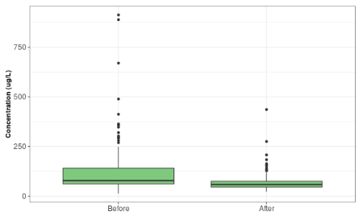
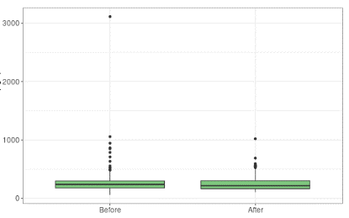
Phosphorus in Streams
Cottonwood Creek Cherry Creek
2002-2012
2013-2021
2002-2012
2013-2021
Concentration ug/l
Concentration ug/l
Median TP Concentrations
significantly lower from 2013-2021
Median TP Concentrations have been maintained despite development
Notes:
Erin New pollution abatement projects, maintenance of existing Pollution Reduction facilities and other WQ improvement activities have been working to reduce TP in CT such as this example before and after the sediment removal in the Perimeter Wetland pond system.
The graph on the left show
Projects and other efforts in CC have worked to maintain TP concentrations despite development and increased inputs.

Slide 10
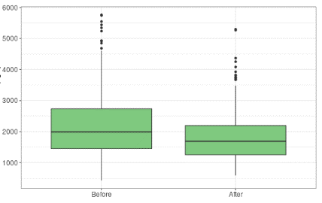
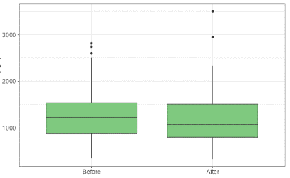
Nitrogen in Streams
Cottonwood Creek Cherry Creek
2002-2012
2013-2021
2002-2012
2013-2021
Concentration ug/l
Concentration ug/l
Median TN concentrations significantly lower from 2013-2021.
Median TN concentrations have been slightly reduced since 2002-2012.
Notes:
Erin New pollution abatement projects and maintenance of existing Pollution Reduction facilities have been working to reduce TN in CT such as this example before and after the sediment removal in the Perimeter Wetland pond system.
Projects in Cherry Creek have worked to slightly reduce TN concentrations when compared to concentrations from 2002 to 2012.

Slide 11
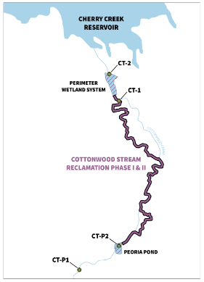
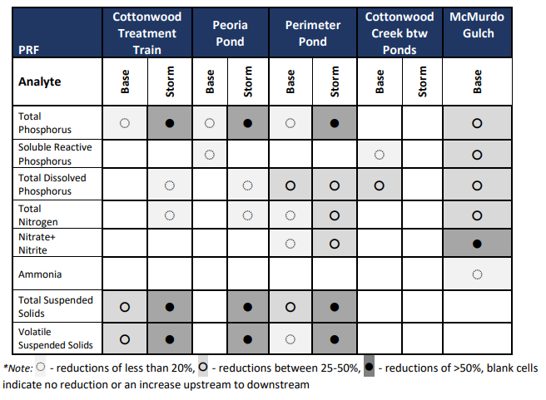
Pollution Reduction Facility
Monitoring
PRFs along Cottonwood Creek effectively reduced TP & TSS, especially during storm flow events.
Notes:
Erin

Slide 12
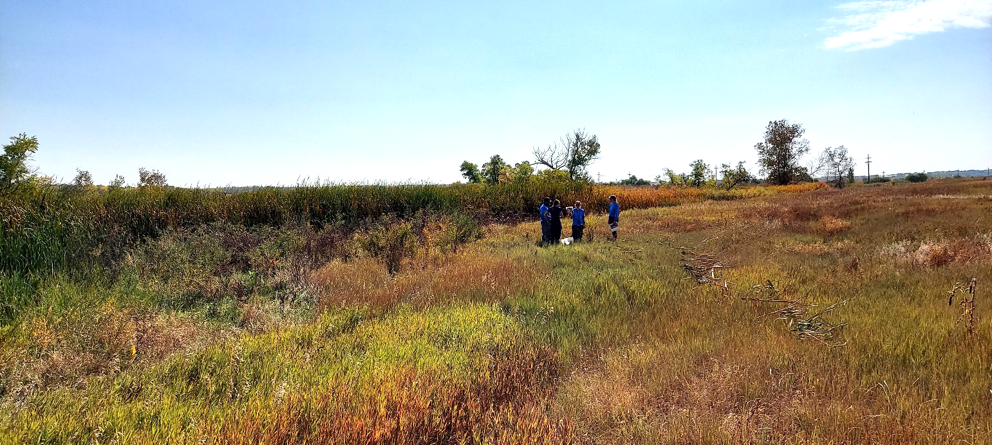
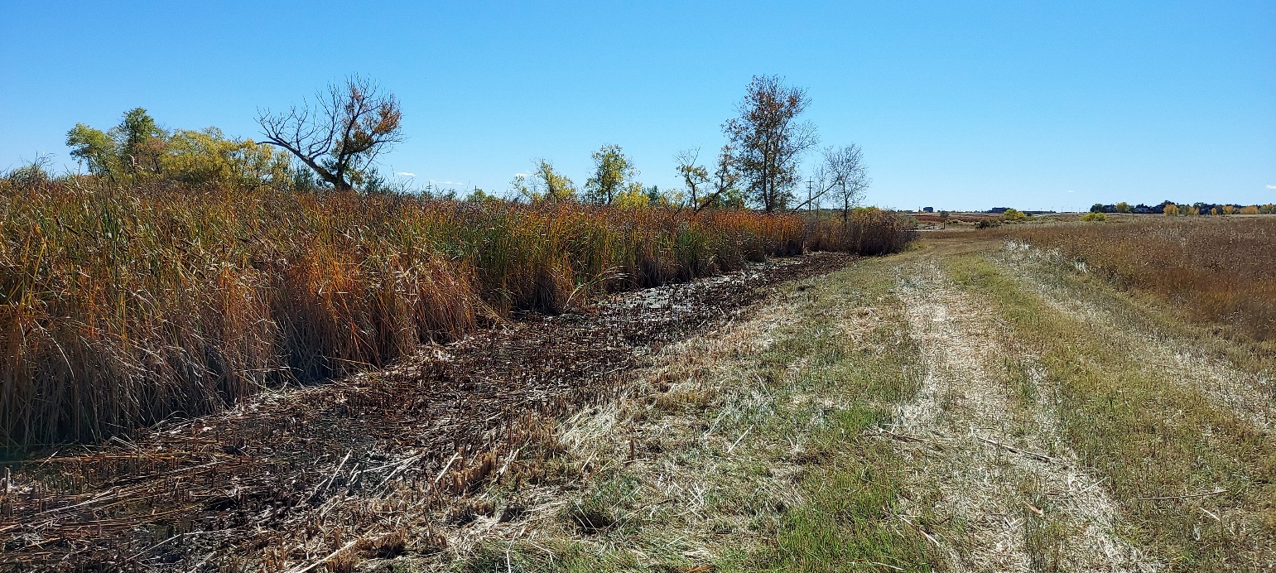
Wetland Harvesting
New project to remove P and N from watershed
Cut and removed wetland plants (primarily cattails) from sides of wetland areas of Cottonwood Creek
2021 efforts removed ~69 lbs of phosphorus and 561 lbs of nitrogen from the watershed
5-year project approved based on results
Notes:
Erin New project to remove P and N from Watershed
Cut and removed wetland Plants (primarily Cattails) from sides of wetland areas of Cottonwood Creek
2021 Efforts removed ~69 lbs of Phosphorus and 561 lbs of Nitrogen from the watershed
5 Year project approved based on results

Slide 13
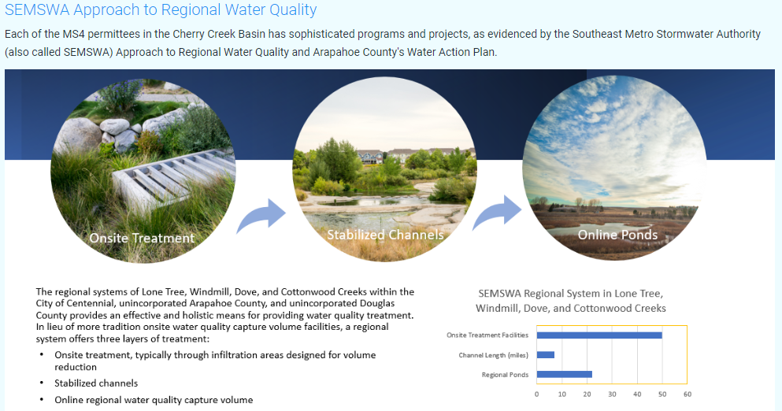
MS4s
Proactive in stormwater control measures:
  Construction & ost-construction
  Maintenance activities
  Preserving floodplains
Notes:
Erin
All MS4s in the CCB have adopted stormwater programs, consistent with Regulation 72, for construction projects within their jurisdictions.
Very proactive and innovative in stormwater management
Contruction Control measures
Maintenance activities
Preserve floodplain areas
and projects to protect water quality

Slide 14
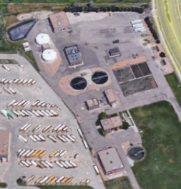

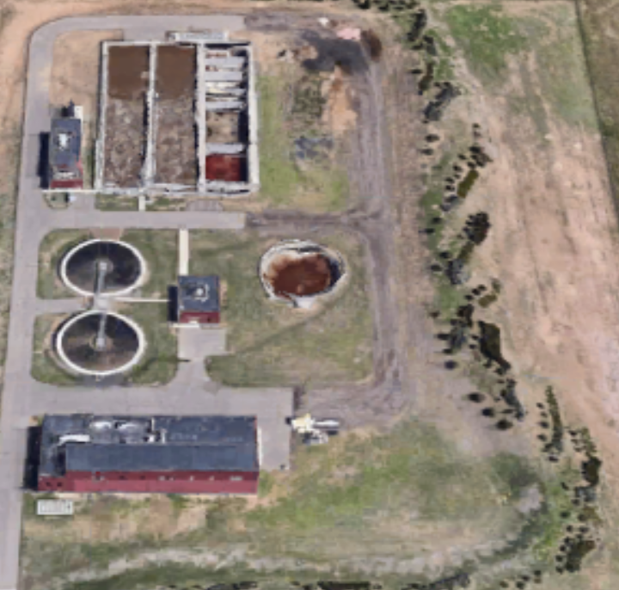
WWTFs
Treat phosphorus to 0.05 mg/L (significantly lower than inflow concentrations to the reservoir or background (0.20 mg/L)
Direct discharge or land application
Notes:
Erin
WWTFs in CC Basin use very advanced treatment processes to reduce nutrients
Treat Phosphorus to 0.05mg/L
significantly lower than weighted inflow concentrations to the Reservoir
Direct discharge or land application

Slide 15
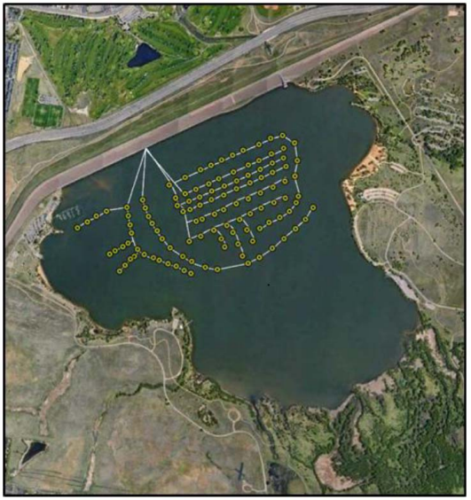
Reservoir Destratification System
Limits stratification when temperatures are not extreme
When dissolved oxygen is high at the bottom of the reservoir, internal loading is reduced
Artificially mixes cyanobacteria
Benefit to fishery
2016
2011
2002
Notes:
Erin
Limits stratification when temps are not extreme
When dissolved oxygen is high at the bottom of the Res, internal loading is reduced
Artificially mixes cyanobacteria
Benefit to fishery

Slide 16
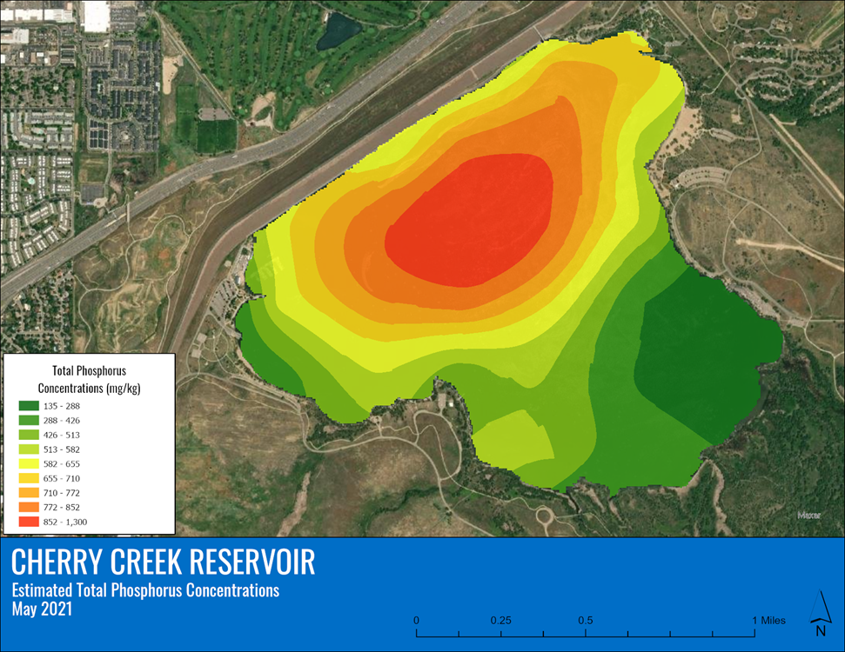
Nutrients in Cherry Creek Reservoir: Sediment Study and Internal P Loading
Nutrients accumulate in the reservoir sediments
2021 Sediment Phosphorus Study in CCR
  Highest P in the deepest areas w/ the most organic sediments
  High P and available P
  Less P in areas around the shoreline with larger particle size (sand and gravel)
Findings generally align with assumptions in Reservoir Model
2016
2011
2002
Notes:
Erin
Nutrients accumulate in the Reservoir (suspended solids, productivity, etc.
2021 Sediment Phosphorus Study in CCR
Highest P in the deepest areas w/ the most organic sediments (sludge)
High P and Available P
Less in areas around the shoreline with larger particle size (sand and gravel)
114 to 2,230 mg/kg within my 20 samples.Barr Lake

Slide 17
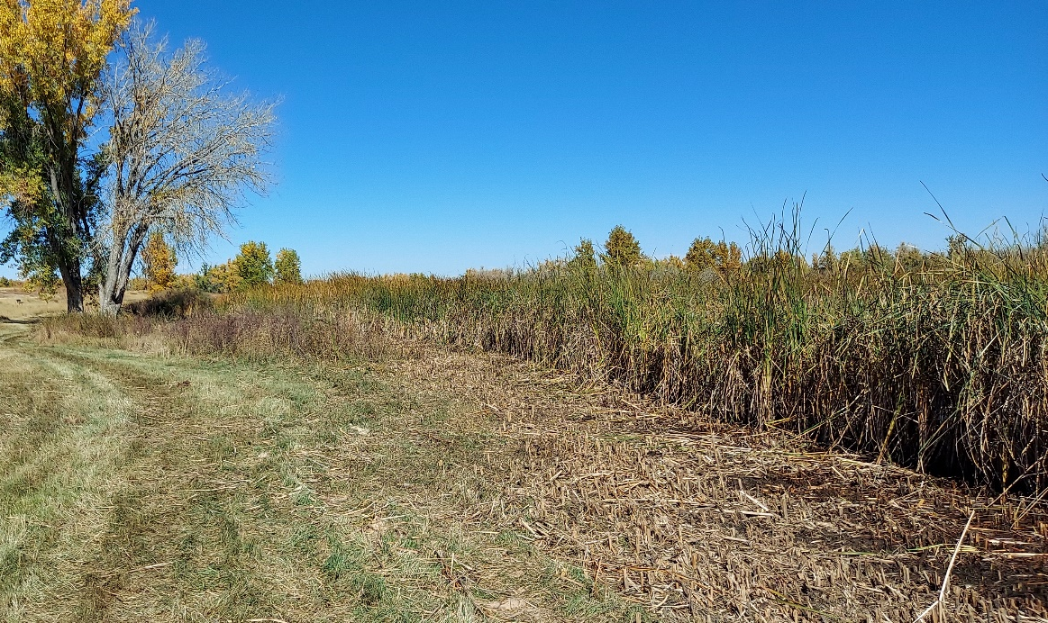
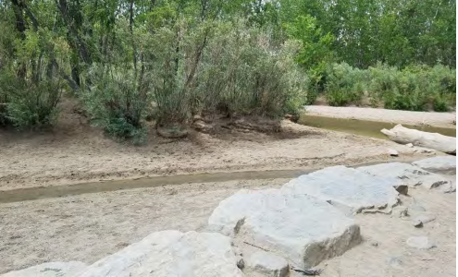
Planning - Other Studies & Projects
Modeling
BMP/SCM Effectiveness Study
Runoff Reduction Study w/SEMSWA & MHFD
Stream Reclamation Projects
Partnering on Master Planning & MHFD Projects
Notes:
Jane

Slide 18

HSPF Watershed Model:
Baseline and 2030 Scenarios

Slide 19

CE-QUAL-W2 Reservoir Model (Hydros 2019)
Key drivers of observed chlorophyll a and cyanobacteria response in reservoir (2000-2017):
Relatively shallow depths and resulting polymictic conditions
High levels of internal and external phosphorus loading
N limitation creating favorable conditions for N-fixing cyanobacteria
RDS provides some benefit in May-early June, but not summer months

Slide 20
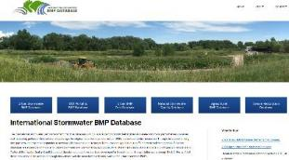
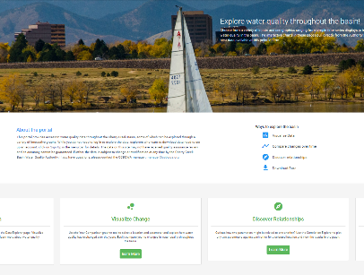
2022-2023 CCBWQA-Sponsored
SCM/BMP Effectiveness Study
www.bmpdatabase.org
Phase 1. Information Gathering and Initial Synthesis
Data analysis and synthesis
Identify opportunities to improve Authority’s stormwater treatment “toolbox”
Relate findings to MS4 Permit requirements
Initial synthesis memorandum
Phase 2. Planning and Authority Engagement
Workshop
Data gaps and opportunities
Final technical memorandum
Cherry Creek
Data Portal
ccbwqportal.org

Slide 21
Colorado Total Phosphorus (mg/L) in Runoff from Reg. 85 MS4 Data Gap Report
Land Use | # | Min | Max | 25th % | Median | 75th % | Mean | COV
COM | 277 | 0.01 | 6.30 | 0.12 | 0.22 | 0.41 | 0.36 | 1.47
HWY | 25 | 0.07 | 2.60 | 0.15 | 0.28 | 0.42 | 0.39 | 1.25
IND | 39 | 0.05 | 1.30 | 0.16 | 0.25 | 0.43 | 0.35 | 0.81
OPEN | 7 | 0.21 | 0.66 | 0.26 | 0.41 | 0.54 | 0.41 | 0.39
RES | 254 | 0.07 | 2.71 | 0.29 | 0.46 | 0.72 | 0.56 | 0.69
COM-HWY-IND | 341 | 0.01 | 6.30 | 0.12 | 0.23 | 0.42 | 0.36 | 1.39
Residential significantly higher than other urban land uses.
No significant difference among other urban land uses (COM-HWY-IND).
See report for 95% confidence intervals for median values.

Slide 22
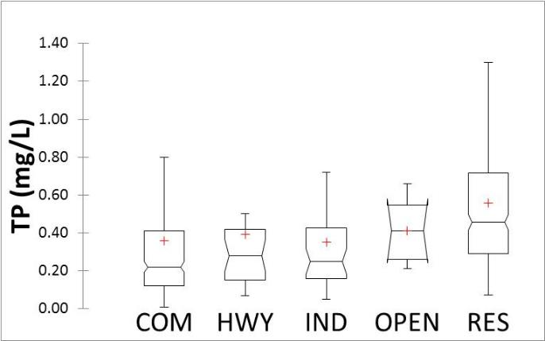
Colorado TP Boxplots by Land Use from Reg. 85 MS4 Data Gap Report
Reg. 72 WWTF Limit 0.05 mg/L For general frame of reference only:
Reg. 85 WWTP limit for existing facilities = 1.0 mg/L
Reg. 31 Warm Water “interim value” = 0.17 mg/L

Slide 23
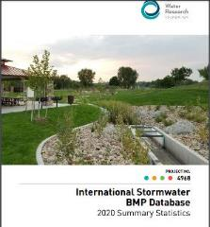
International Stormwater BMP Database www.bmpdatabase.org
Most recent Update: 2020
Hundreds of Green Infrastructure practices
Over 120 manufactured devices
2022 update in progress will include MHFD data

Slide 24
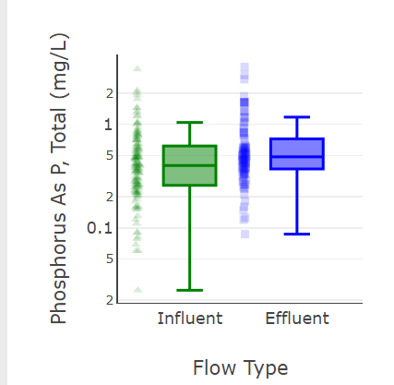
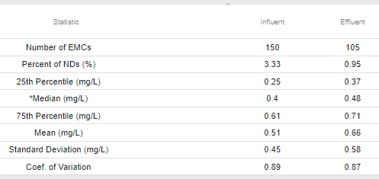
Example Analysis: Phosphorus Removal in Bioretention in Colorado
21st & Iris (2 designs), River Run, City of Fort Colins (2 designs)
Inflow
Outflow
0.4
0.48

Slide 25
Example: Bioretention Take-aways for TP Load Reduction
Performance: P load reductions can be substantial for bioretention facilities—volume reduction drives this.
Design opportunities to reduce P export
    Improve basic media mix design (MHFD Vol. 3 in progress)
    Consider specialty amendment? (National Research)
Monitoring: Accurate volume measurements are challenging.
Research needs
    Better estimates of volume reduction
    Continue to monitor enhanced media mixes
MHFD 21st & Iris Example

Slide 26
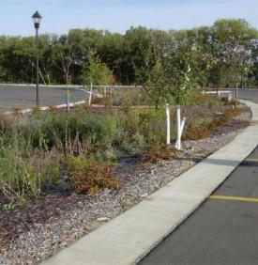
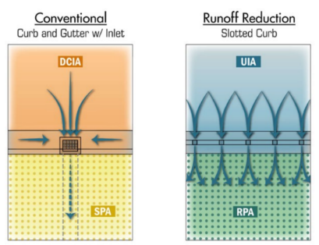
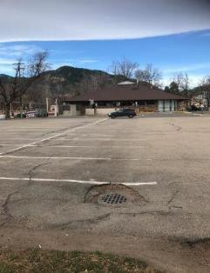
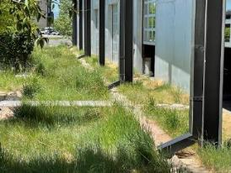
Encouraging Runoff Reduction:
Receiving Pervious Area (RPA)
ENCOURAGE
DISCOURAGE
Recognizes pollutant load reduction through volume reduction
Reduces impacts to streams (e.g., erosion/sediment)
ENCOURAGE

Slide 27

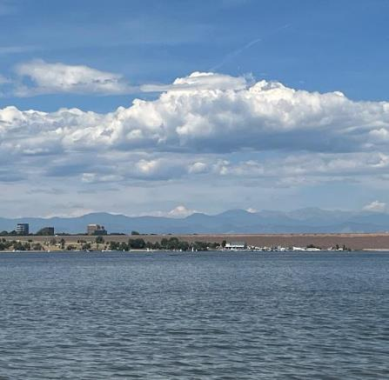
Take-Aways
There is no “silver bullet” to meet chlorophyll-a standards in Cherry Creek Reservoir.
Monitoring and modeling continues to support science-based planning & prioritization of pollutant reduction efforts.
CCBWQA continues to pursue a multi-pronged approach to reduce nutrient loading.
Both watershed controls and in-reservoir approaches are important.
Effective stormwater management starts at the source with runoff reduction at the site scale.
Pollutant load reduction (not just concentration) must be considered when selecting stormwater controls.
Stream reclamation provides multiple benefits and is a key tool in the Cherry Creek Basin toolbox.

Slide 28

Questions?
Jane Clary
Wright Water Engineers, CCBWQA
Erin Stewart
LRE Water, CCBWQA

